Slide 1
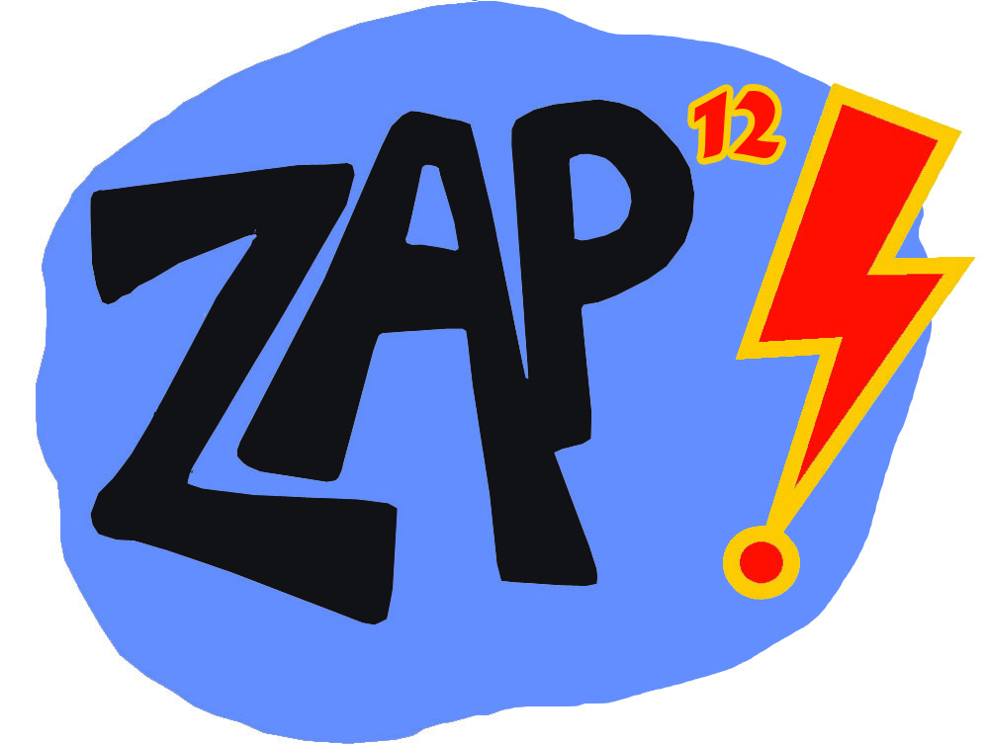
Zap 9
Zap 12 on Mt Charleston
Presented by: Clark County Parks & Recreation and Commissioner Larry Brown
With essential partners: NV Energy, LVVWD, US Forest Service, the Las Vegas Metropolitan Police Department, the Mt. Charleston Town Advisory Board, the Mt. Charleston Library, the Mt. Charleston Lodge, the Nevada Department of Transportation.

Slide 2
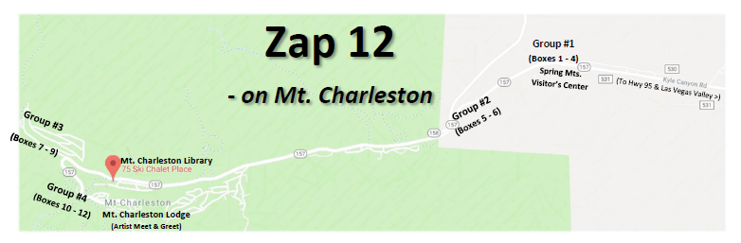
Zap 12 Artists
Brenda Talley → (Group #1)
Jorge Ceja (Vezun) → (Group #2)
Clint Brill → (Group #3)
Aniko Doman → (Group #4)

Slide 3
Brenda Talley
Group 1 – by the Spring Mountains Visitor’s Center
As a 4th generation native Las Vegan, whose grandmother came to this area prior to its founding, I have deep roots in Southern Nevada. Mt. Charleston was a favorite place when I was growing up for picnics and a respite from the Vegas summer heat.
As a Mt. Charleston resident I have a great concern in the destruction of our mountain environment, especially our trees. 300-500 year old Ponderosa Pines and 1000-3000 year old Bristle cone pines; many to fires, the most recent in 2013, but also other trees to the bark beetle and most recently to the salt on our highways during winter. I believe the number was over 700 ponderosa pines that had to be cut down along our roadways due to the salt. I have worked with others, in trying to stop this destruction, working with students that made a documentary to help educate our politicians in the importance of protecting this unique old growth forest.
▫▫▫▫▫▫▫▫▫▫
With that mindset, my wish is to create a piece that reflects the beauty of and importance of protecting all of the ecosystems of this mountain. I envision a piece with various trees, the ponderosas, junipers, and aspens; perhaps with rabbit brush in bloom, and other mountain wildflowers. Perhaps a deer may show its face on one side, or the Palmer Chipmunk, perhaps a few Mountain Blue butterflies and maybe Cocks Comb Ridge or Mummy’s Toe in all their grandeur when gleaming with the sunsets golden kiss would honor one panel.
As a piece of public art, I believe the artist for these utility boxes should consider what this community values, the art would reflect a portion of the environment in which the boxes exist, and hopefully they would heighten our awareness of why it is so important to protect the resources of this very special forest. That would be my goal with this project should I be chosen.

Slide 5
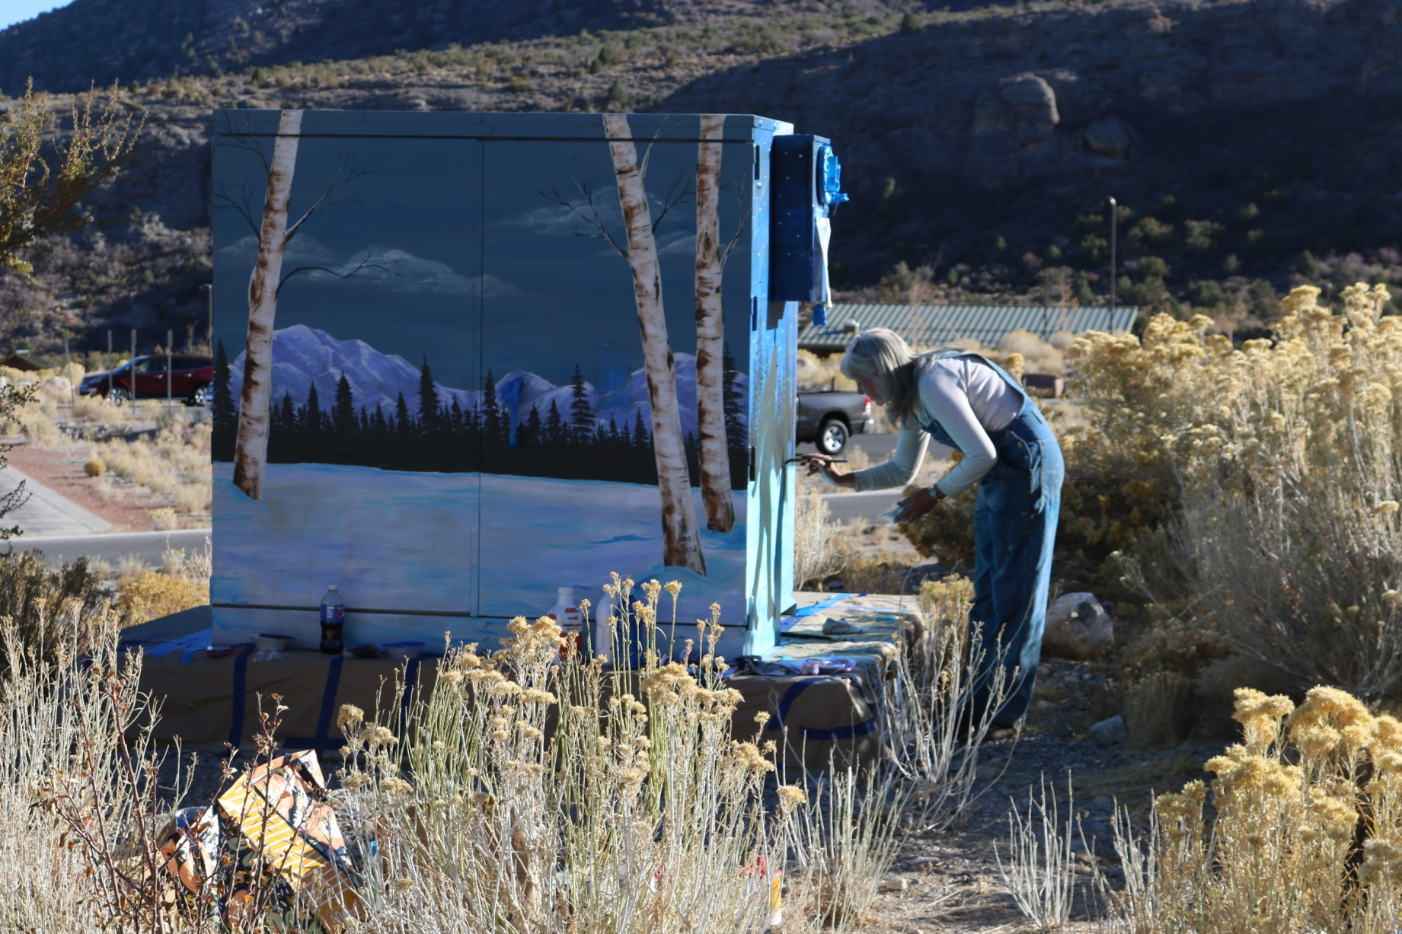
Brenda Talley

Slide 6
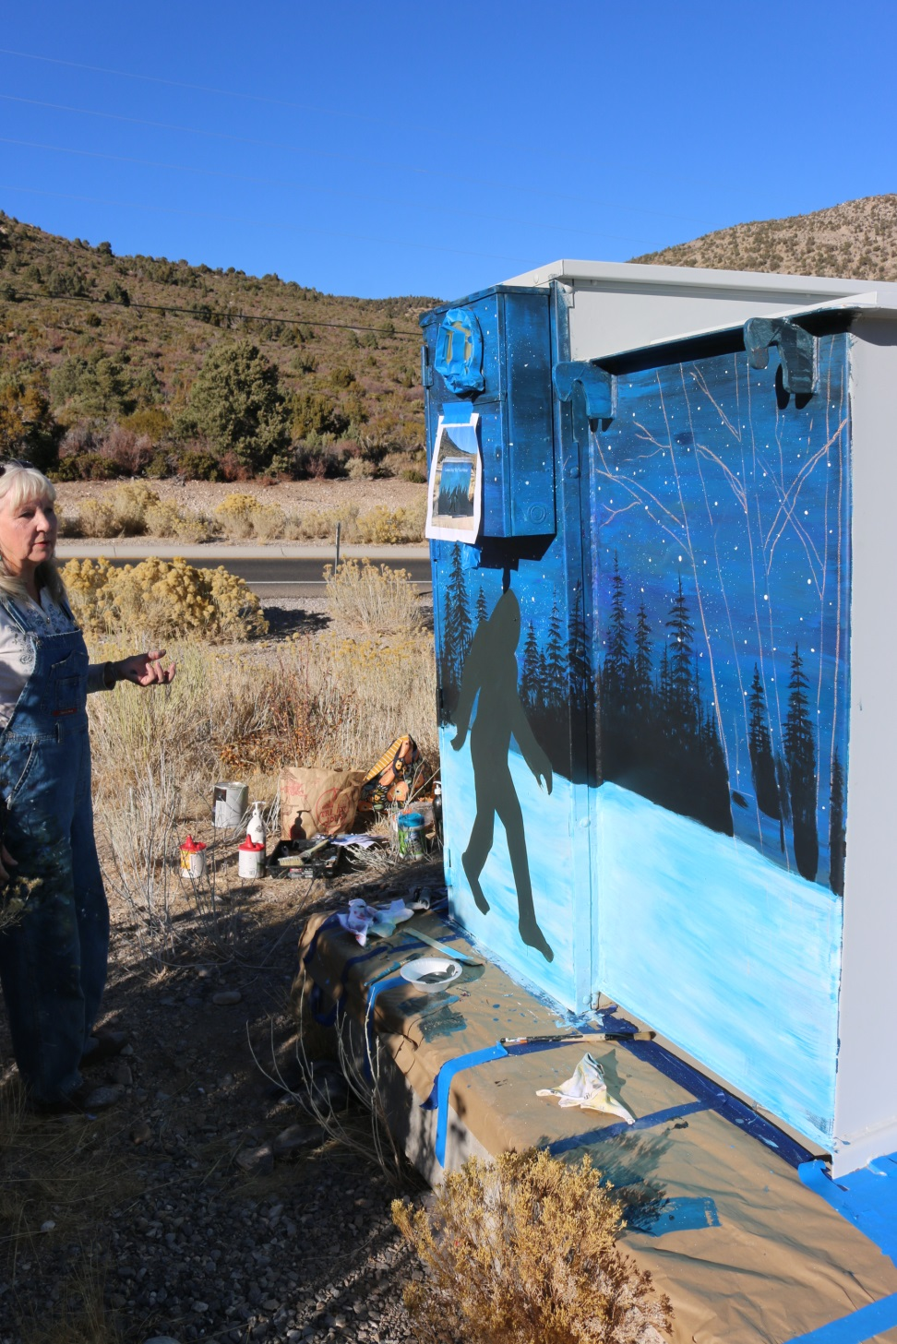
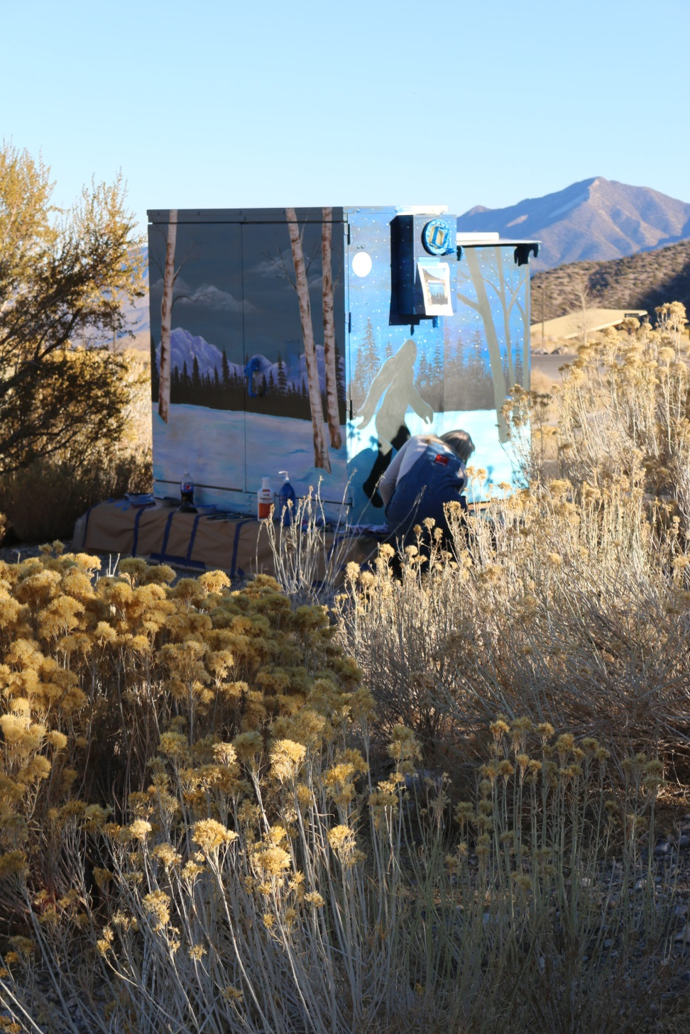

Slide 7
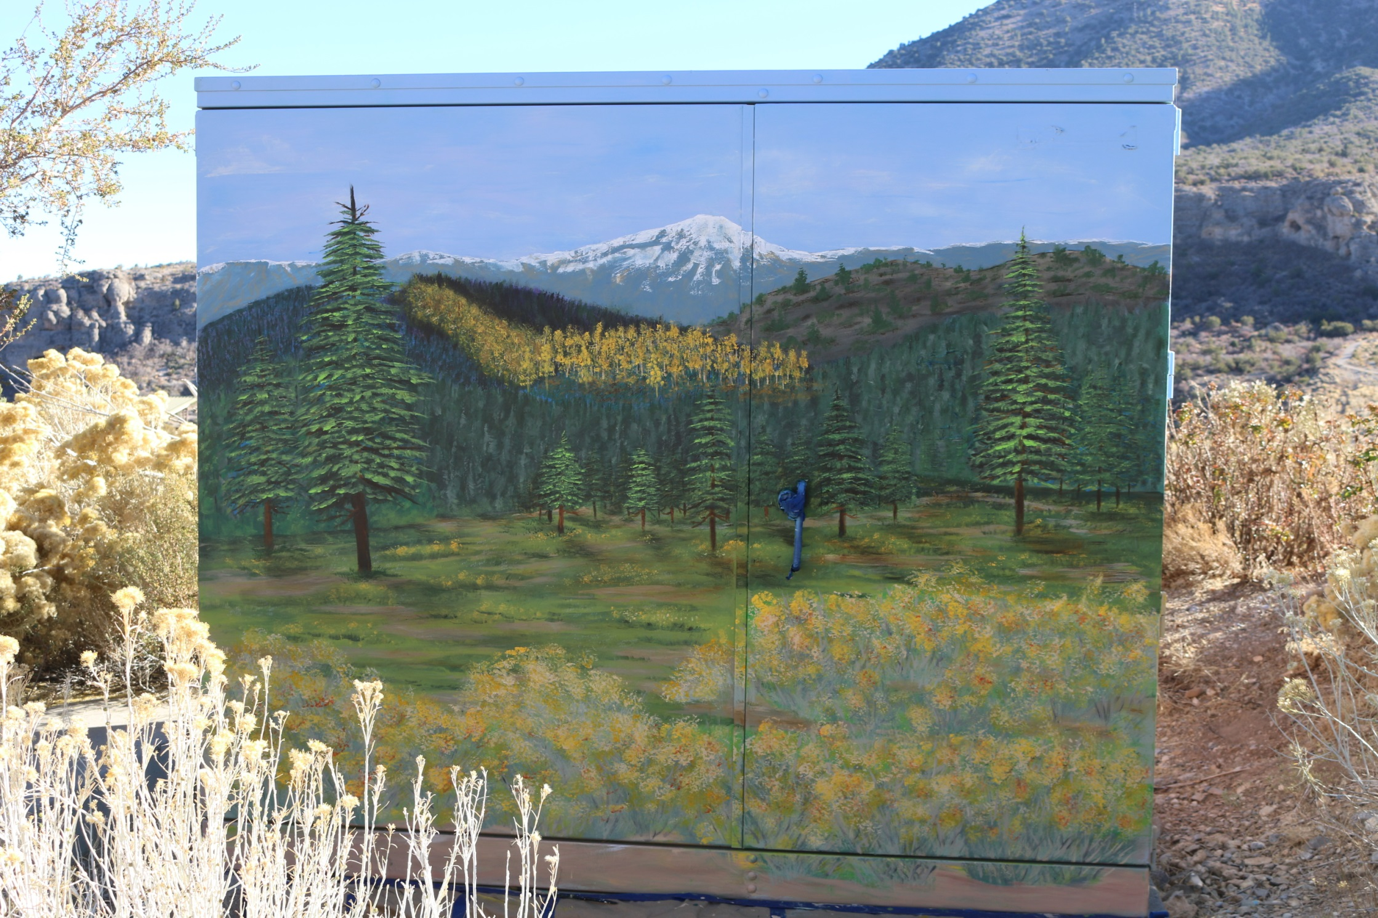

Slide 8
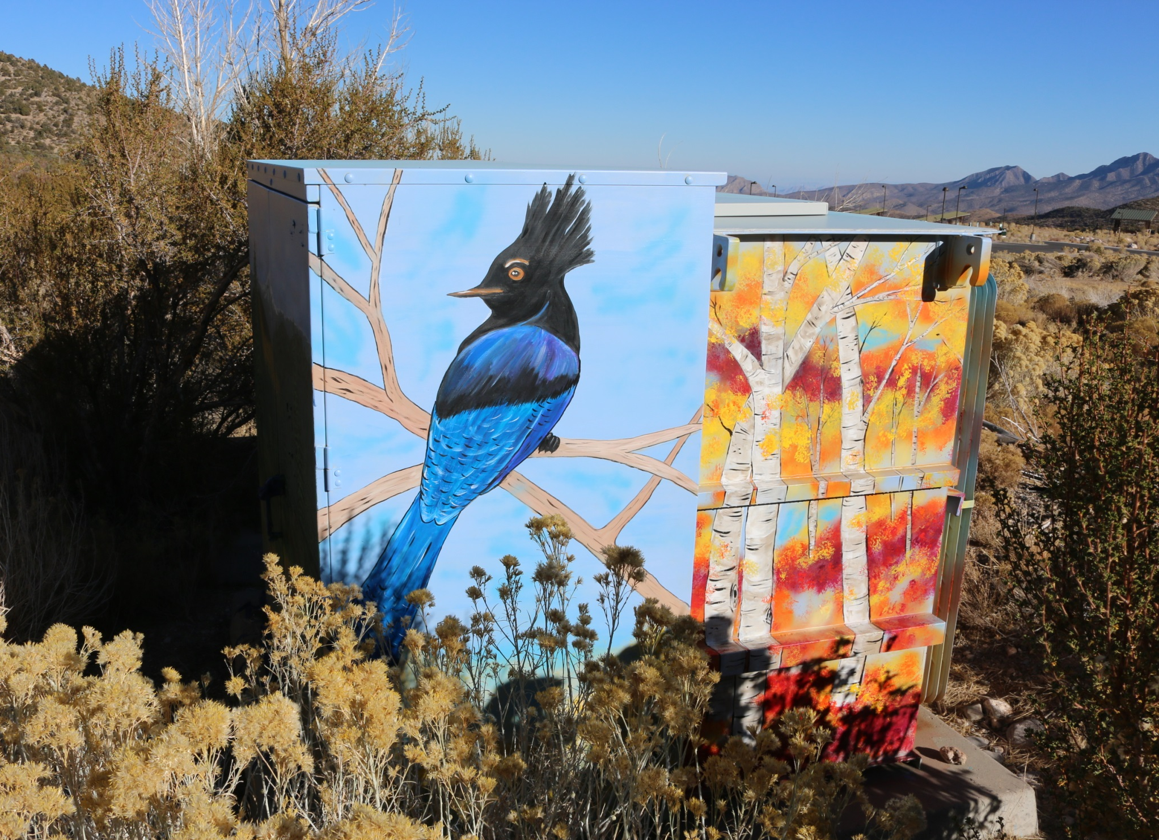

Slide 9
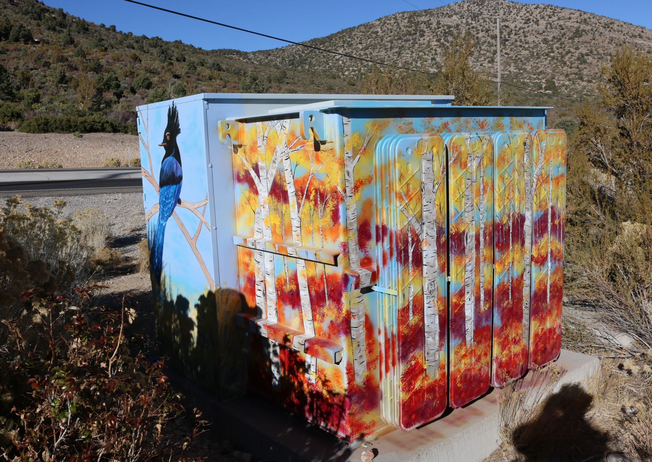

Slide 10
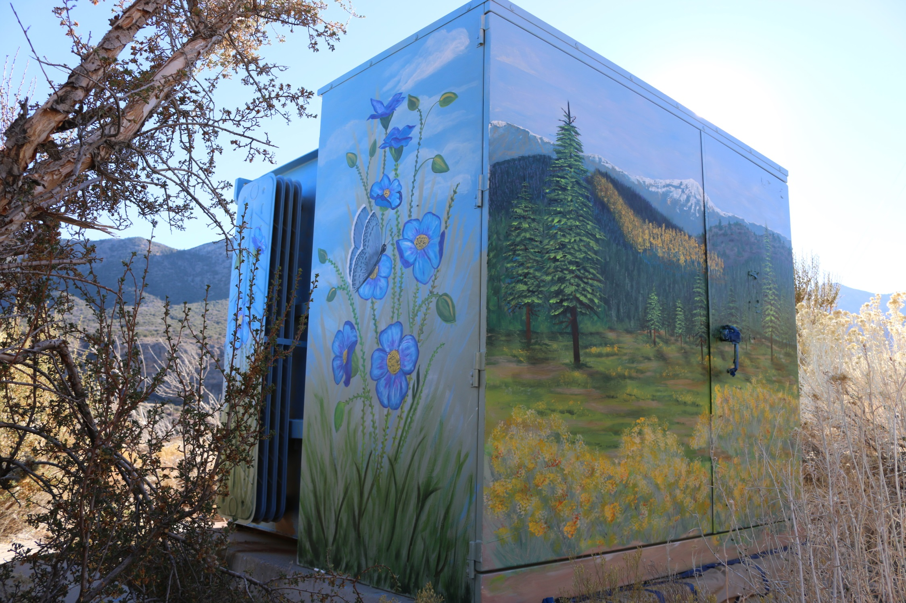

Slide 11
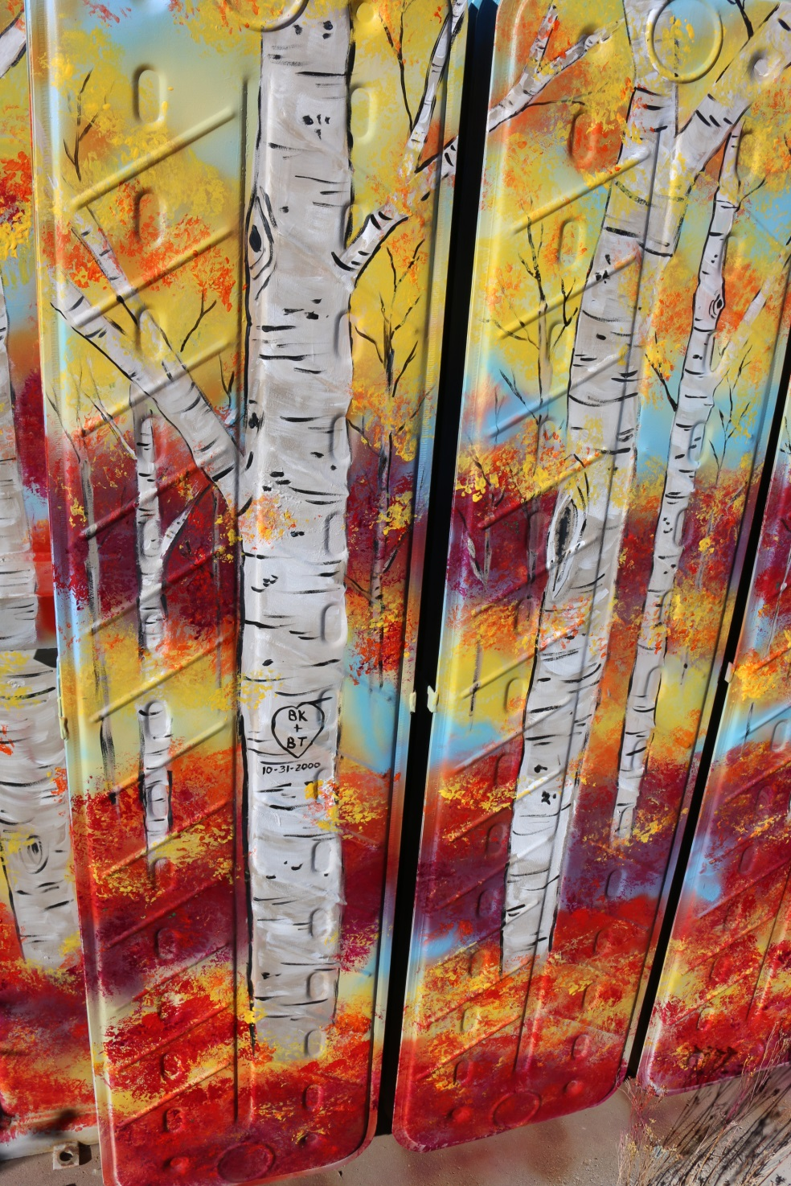
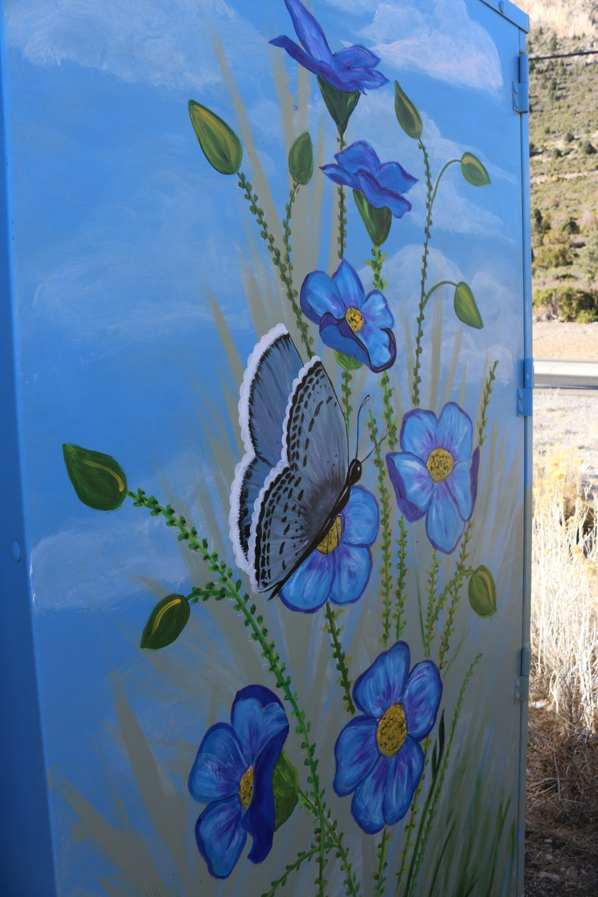

Slide 12
Jorge Ceja (Vezun)
Group 2 – above the Resort & by the turnoff to Hwy-158
(at the top of the gravel road to the old golf course)
I have long been interested in contributing to the Zap project. I can see the added personality that the boxes give to the neighborhoods around town and they also serve as reminders of the creative locals that we have and what they do here. The boxes brighten our days while passing them in transit. I am ready to contribute with paintbrushes in hand and a head full of ideas. I am enthusiastic to be a member of this project and also with further calls where I can continue to lend a hand in building our growing collection of public art pieces.
Along with others, Mount Charleston is one of our gems. I’ve hiked, skied and snowboarded there. I’ve had hot cocoa in the lodge. I have shown it off to visitors and just taken drives to getaway there. I’ve never painted there. My idea is to make boxes that would only be out of place in a photograph. They would only make sense where they are, a literal example of site-specific.
▫▫▫▫▫▫▫▫▫▫
I have contributed to small community projects around town as an artist and presenter opening the doorway for public engagement and discussion. I have also been a part of civic art activities which invite attendees to join in on the process and the activity.
My intention is to be very traditional and do my boxes in a Plein Air approach. Drawing the surroundings into the piece not only as inspiration but as a subject. This would not be that different than what a lot of artists do to learn or as a regular mode of operation for their work. Look and paint, that is my intention except as a Zap box this would serve as a mirror for the immediate surroundings and the county as a whole. The mountains in this painting are not “made up” mountains, they are the mountains in front of you. We live here. This is the imagery.

Slide 14
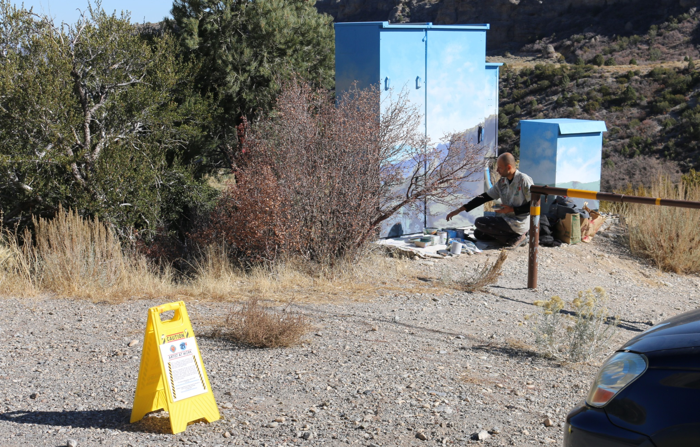
Jorge Ceja (Vezun)

Slide 15
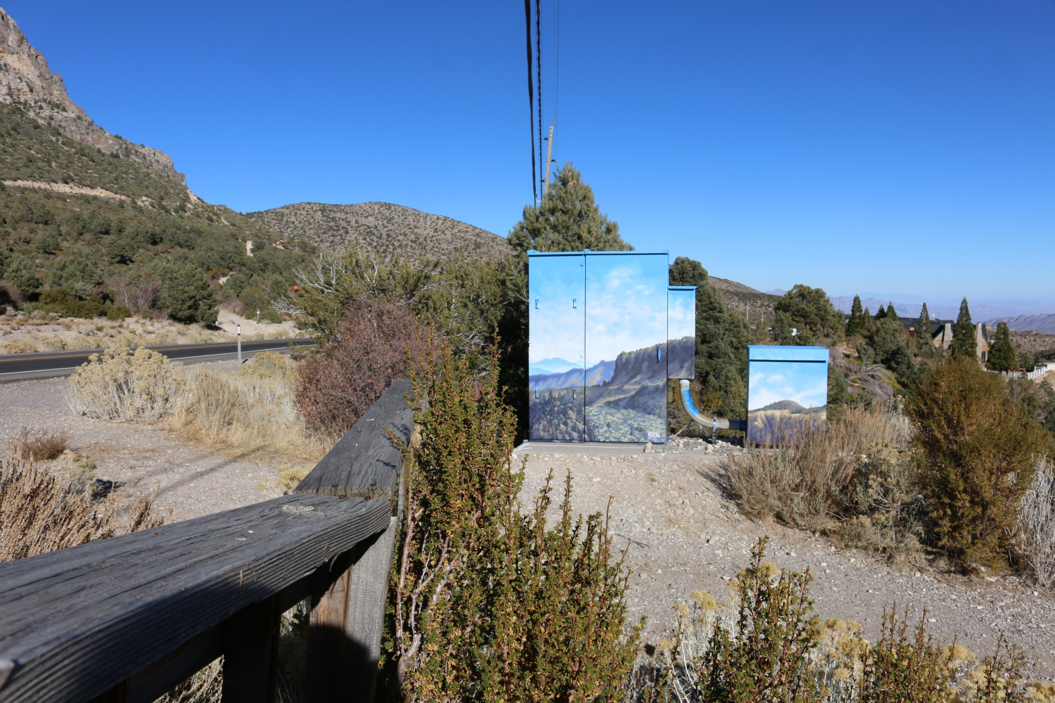

Slide 16
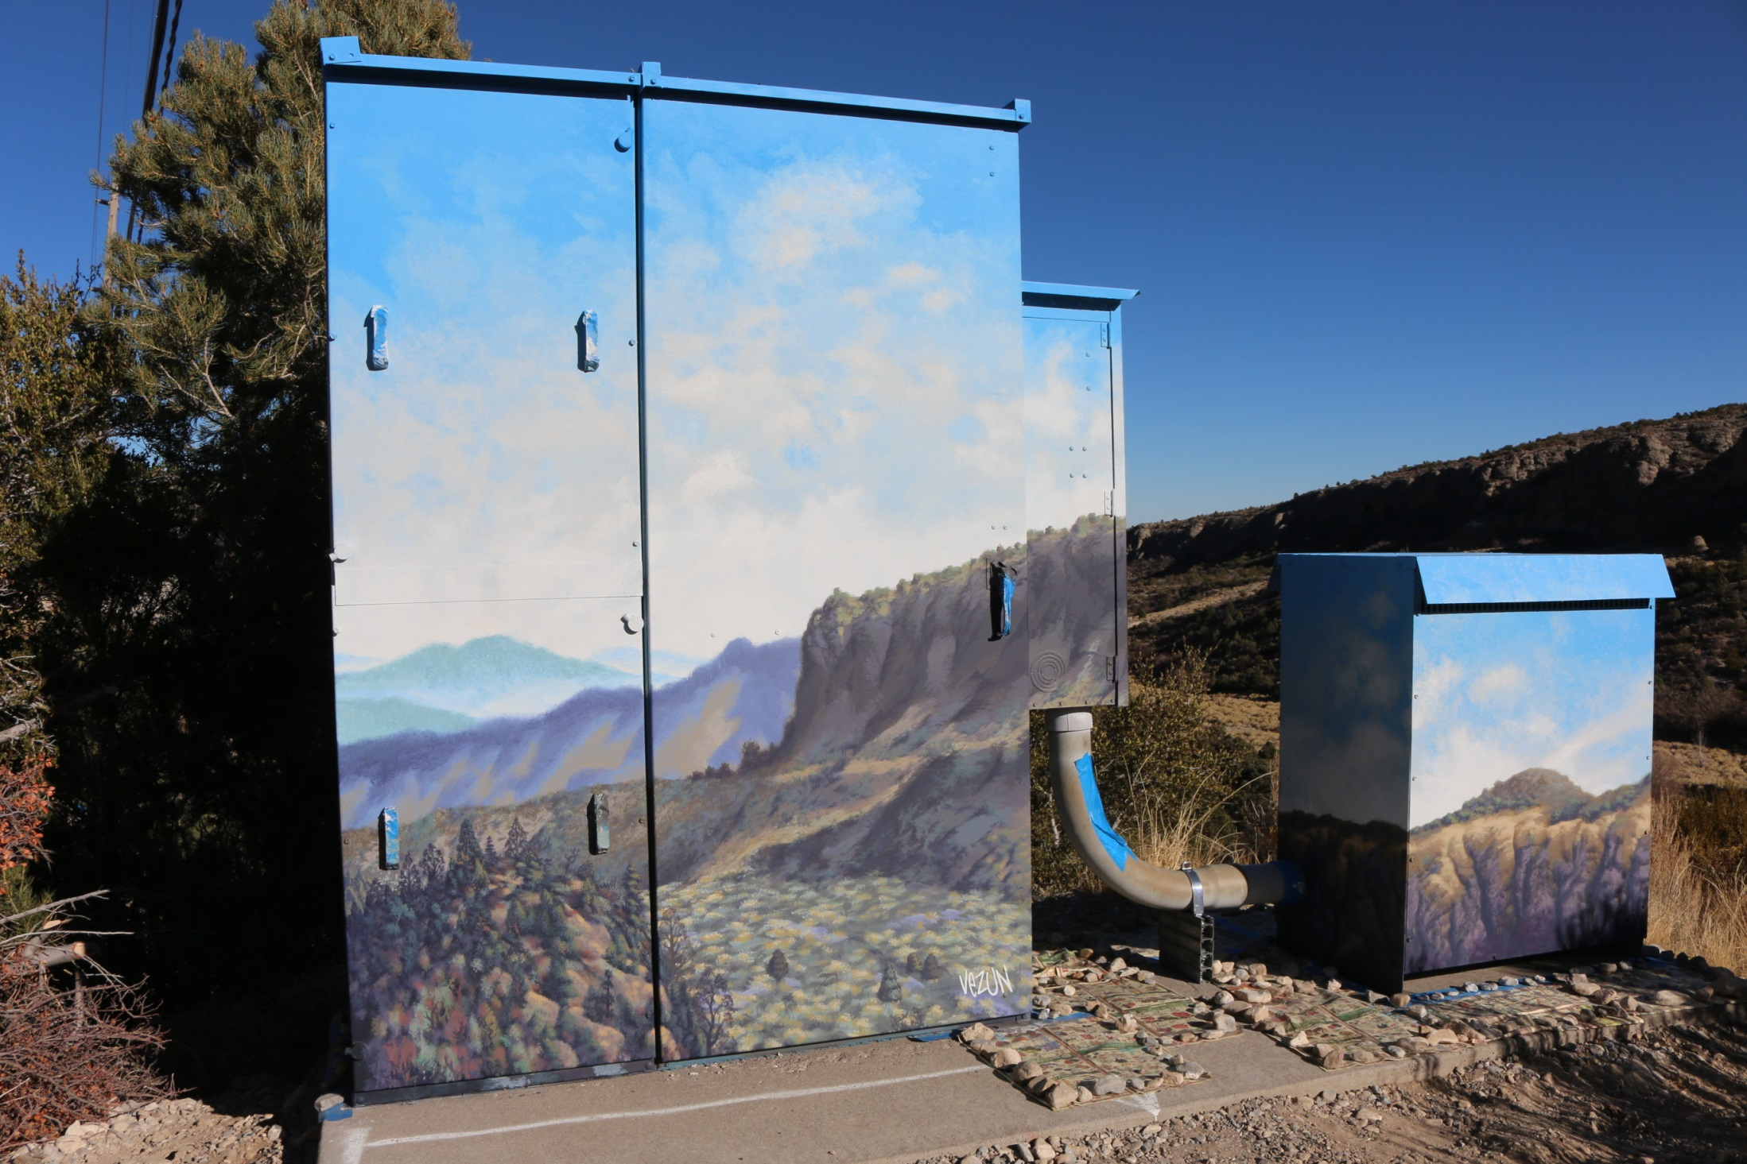

Slide 17
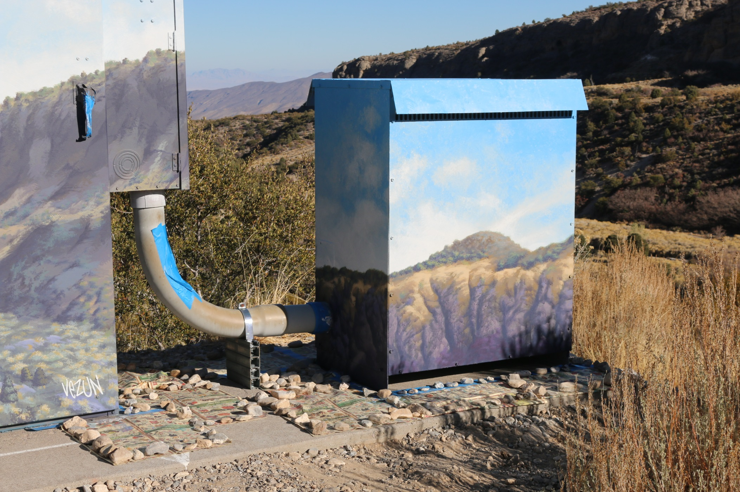

Slide 18
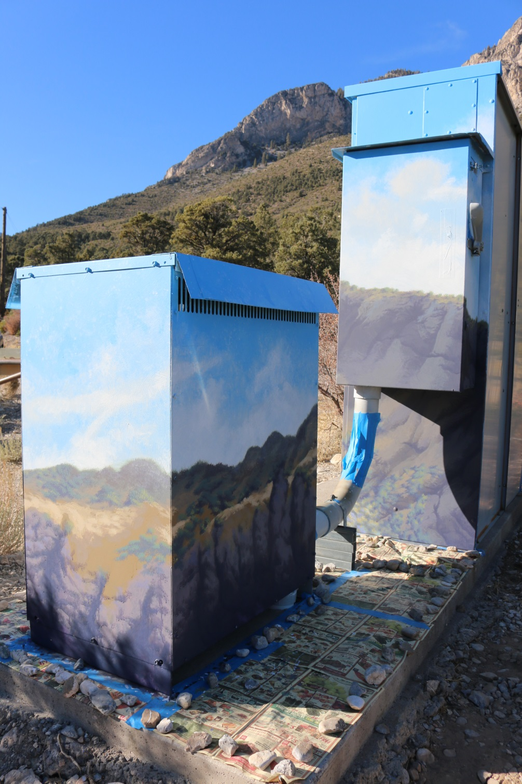
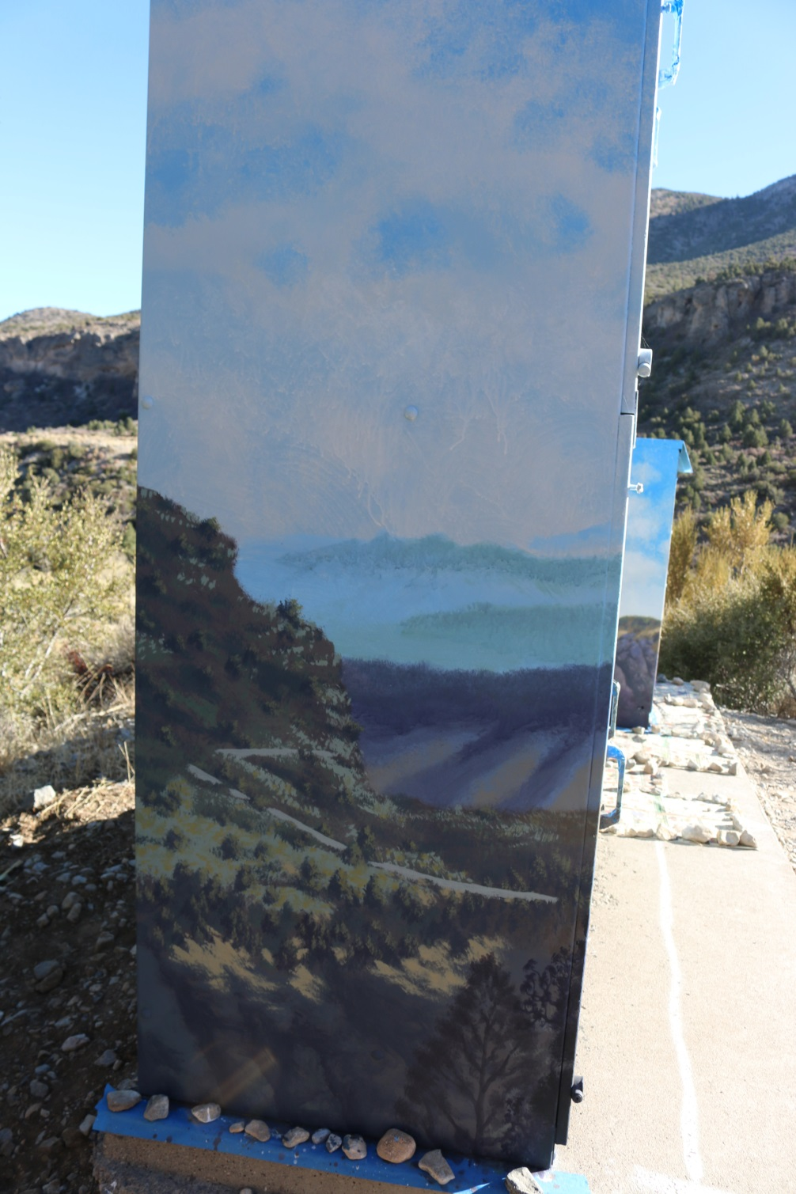

Slide 19
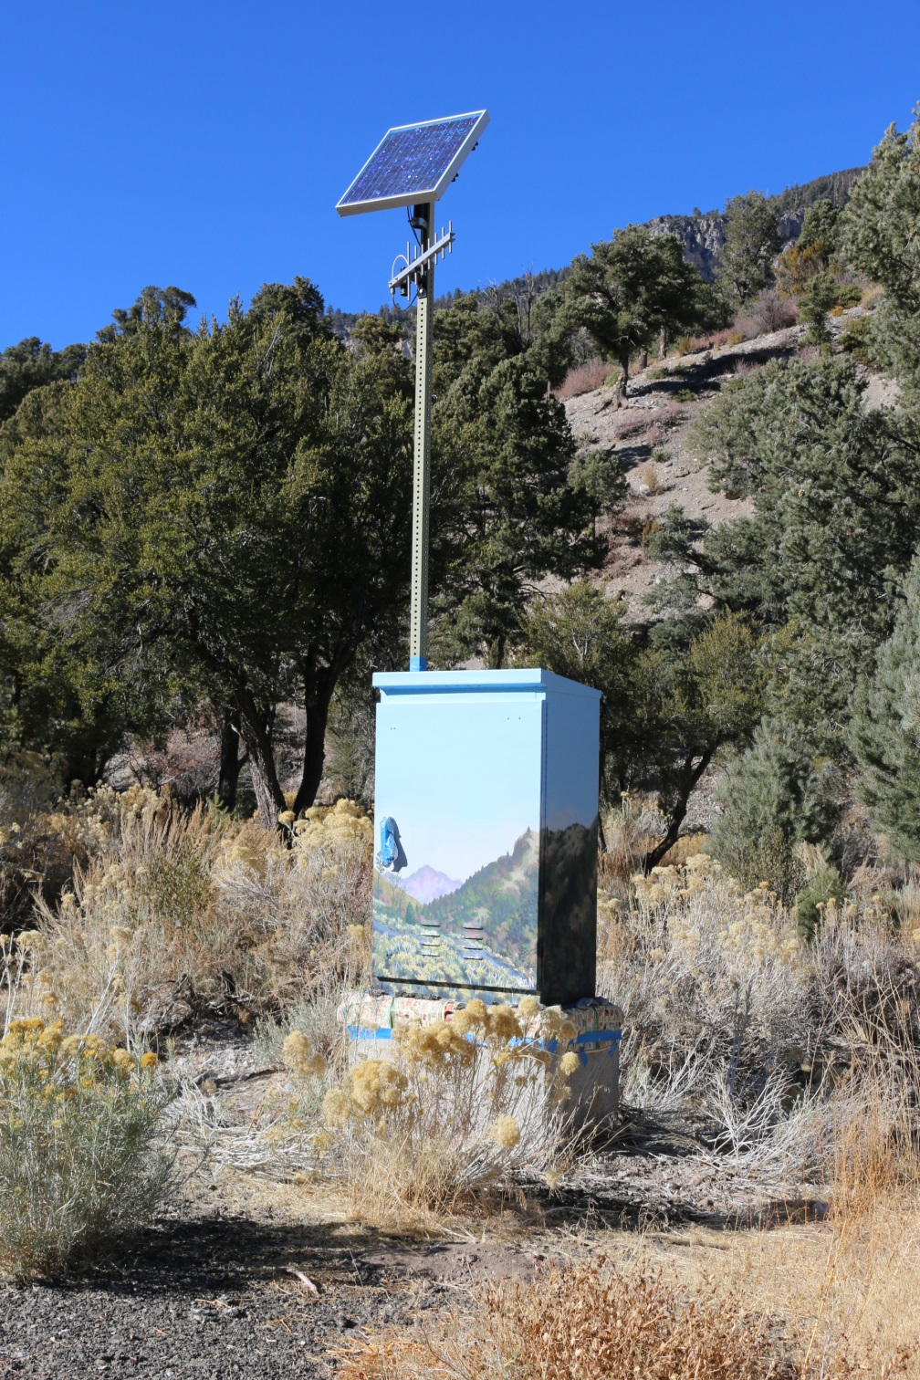
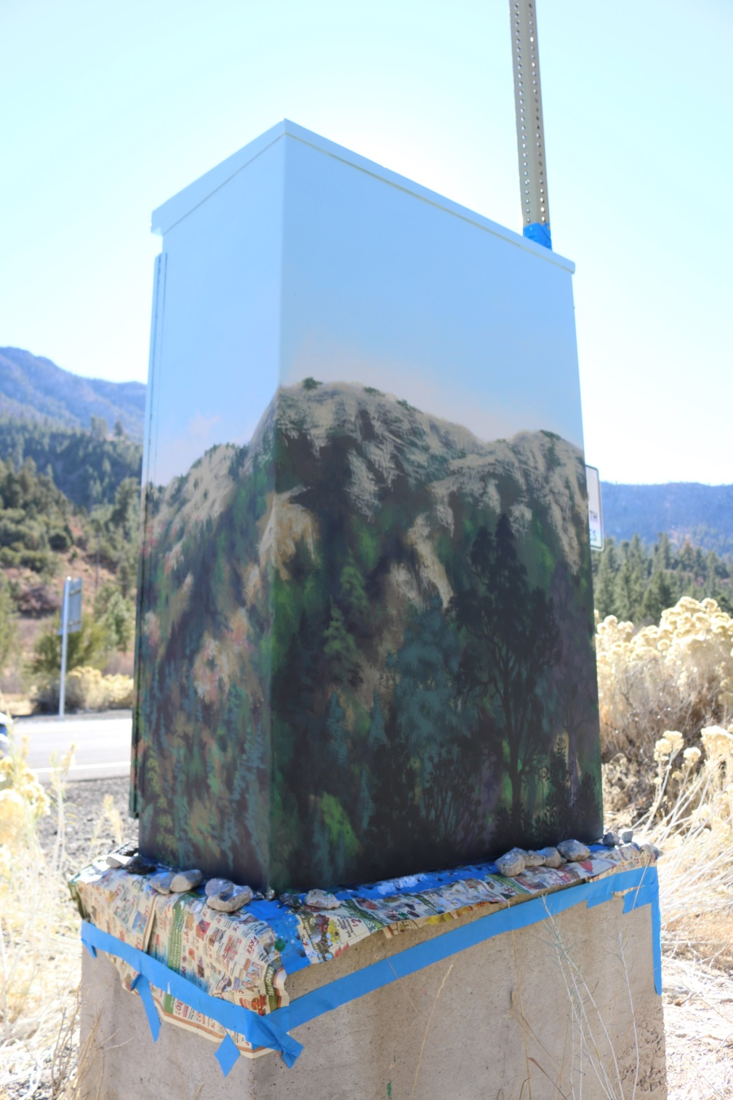

Slide 20
Clint Brill
Group 3 – At the Well Echo #5 Pump House & 64 Crestview Dr.
(by the Trail Canyon trailhead)
I have always loved the work of the American Regionalist Artists; Grant Wood, John Stuart Curry, and especially Thomas Hart Benton. I like their authenticity in how they represented rural life so well. This is pertinent to my own upbringing on a farm in the Midwest where images from rural life were common for subjects in my drawings from a very early age.
As a student of Design at the Colorado Institute of Art, I learned to appreciate good composition (which is also evident in Benton’s work). I was able to expand my familiarity with various media in my studies for my Master’s Degree in Art from Northern Arizona University. My training was enhanced through my Art teaching career with Clark County School District and as an adjunct Art teacher with College of Southern Nevada.
▫▫▫▫▫▫▫▫▫▫
My goal is to represent the community in which my work will be on display through good design, as well as images which enhance and spark interest. Materials will be of good quality, purchased at our family business: “Graphx Signs & Services”, where we also sell supplies for artists. This is where I maintain the role of artist/illustrator for the business.
I have also done other murals; through Graphx, independently, and as an educator with students and community involved in the process.

Slide 22
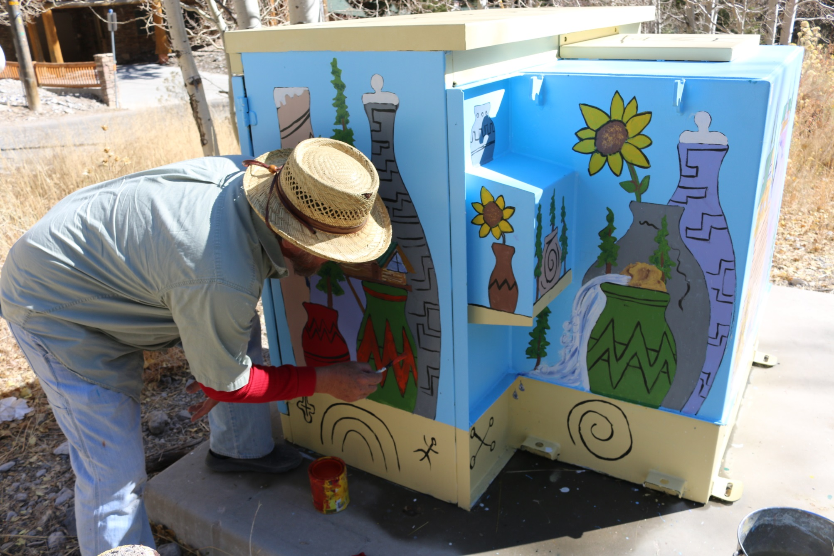
Clint Brill

Slide 23
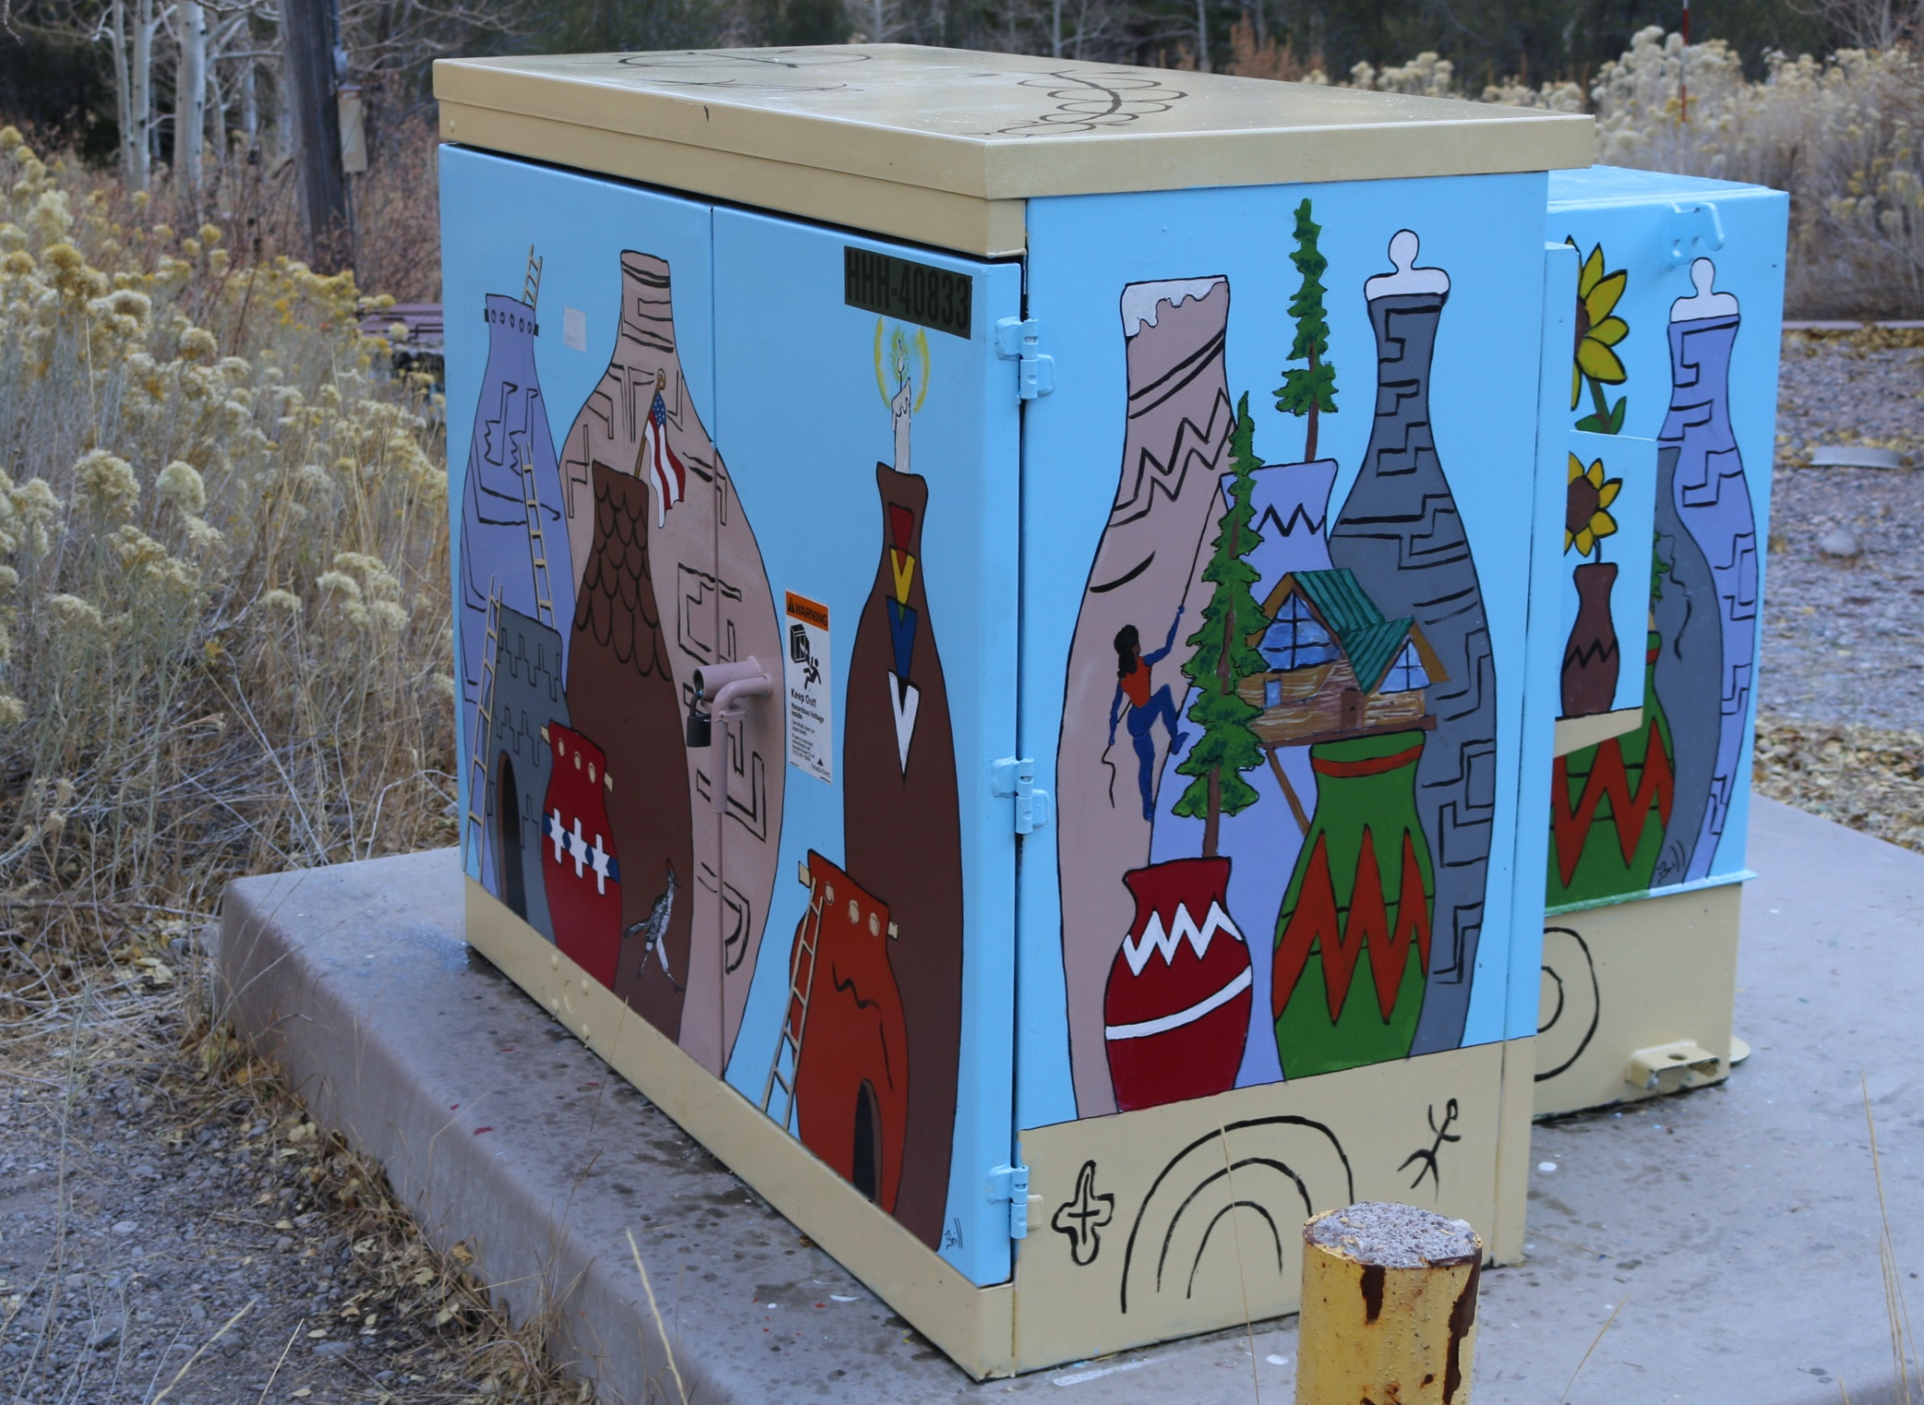

Slide 24
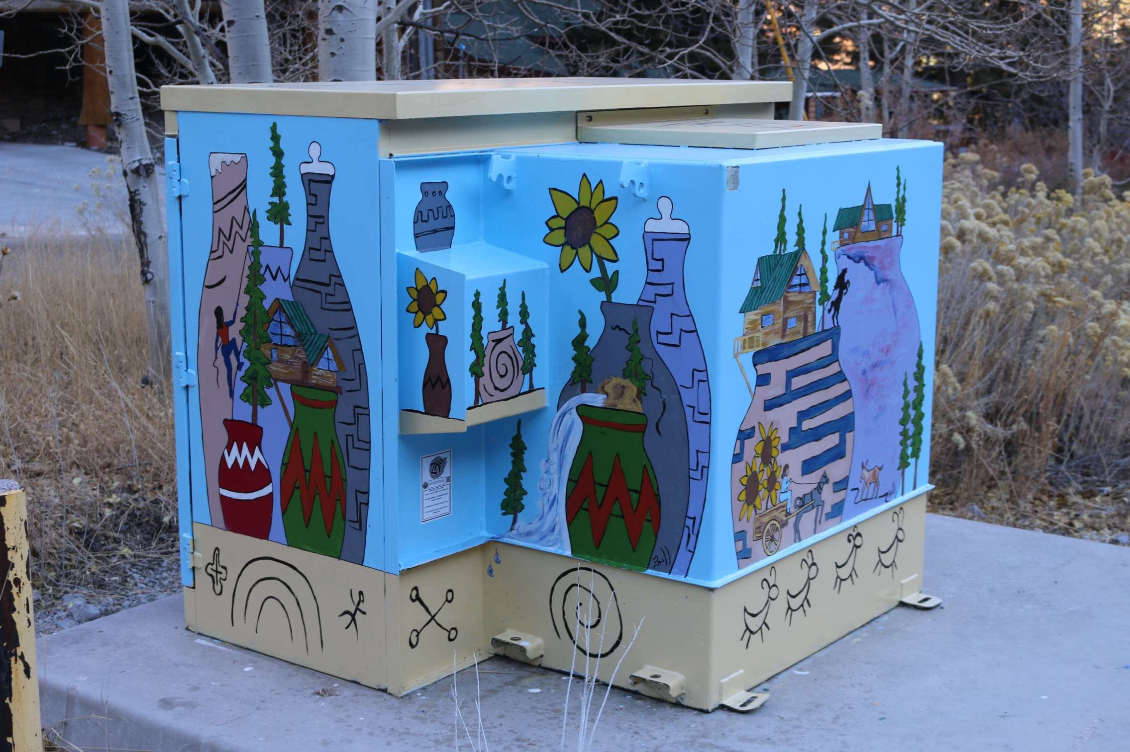

Slide 25
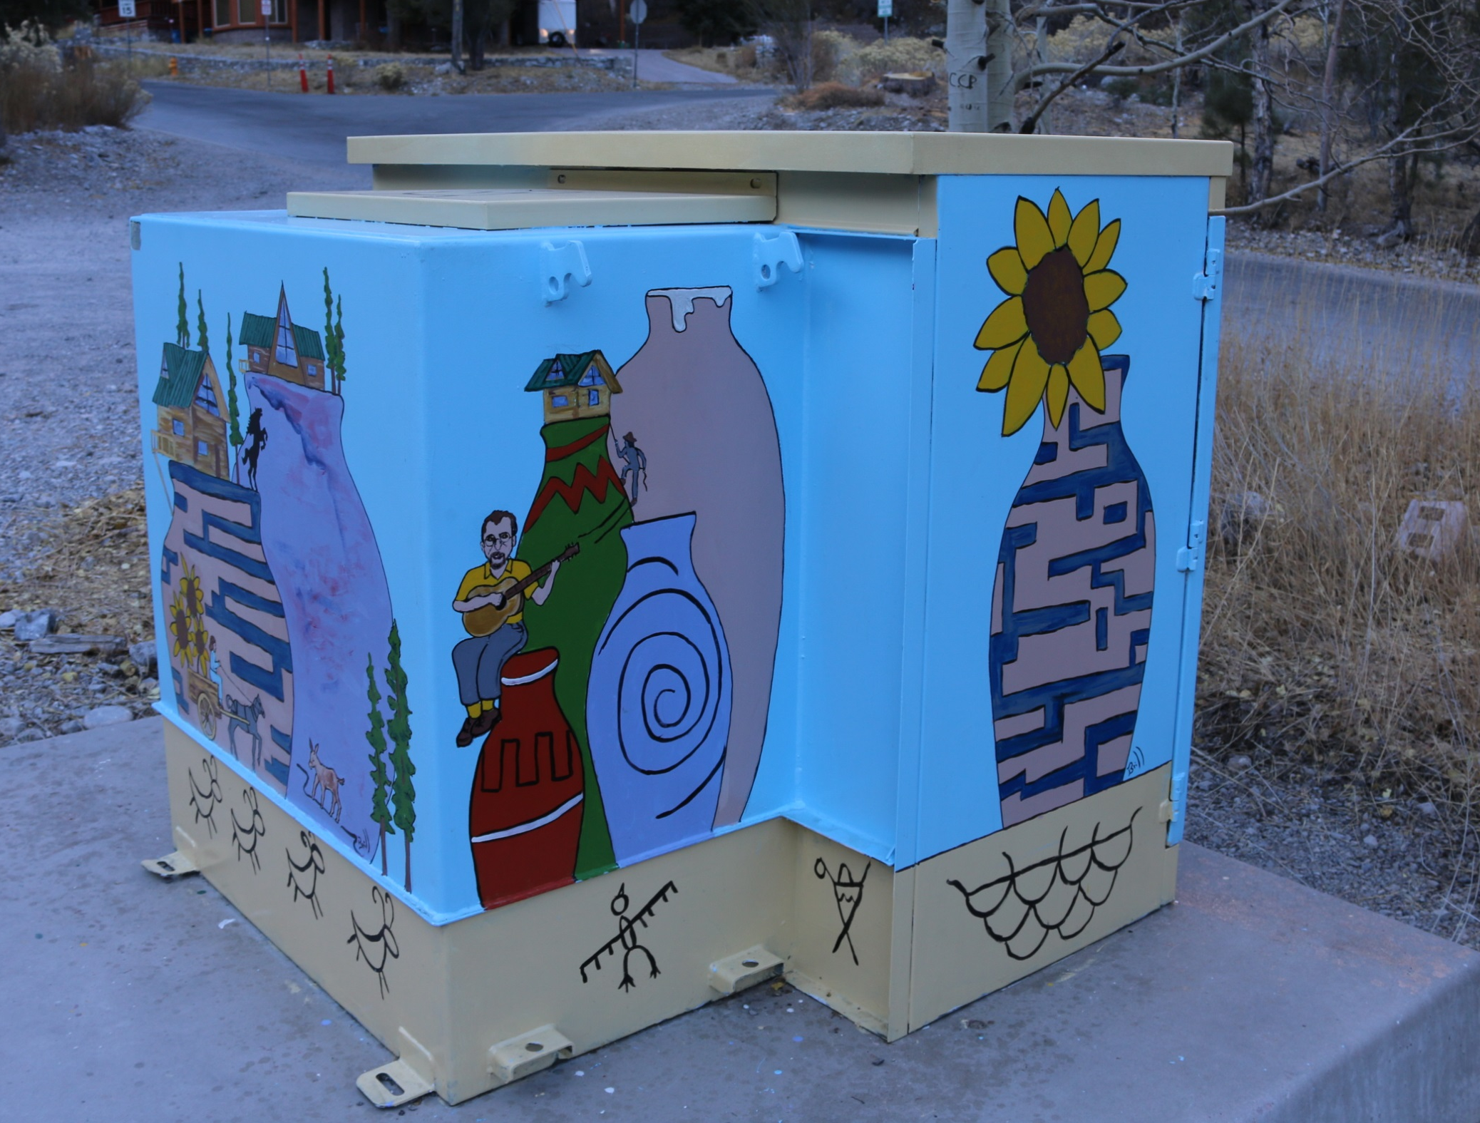

Slide 26
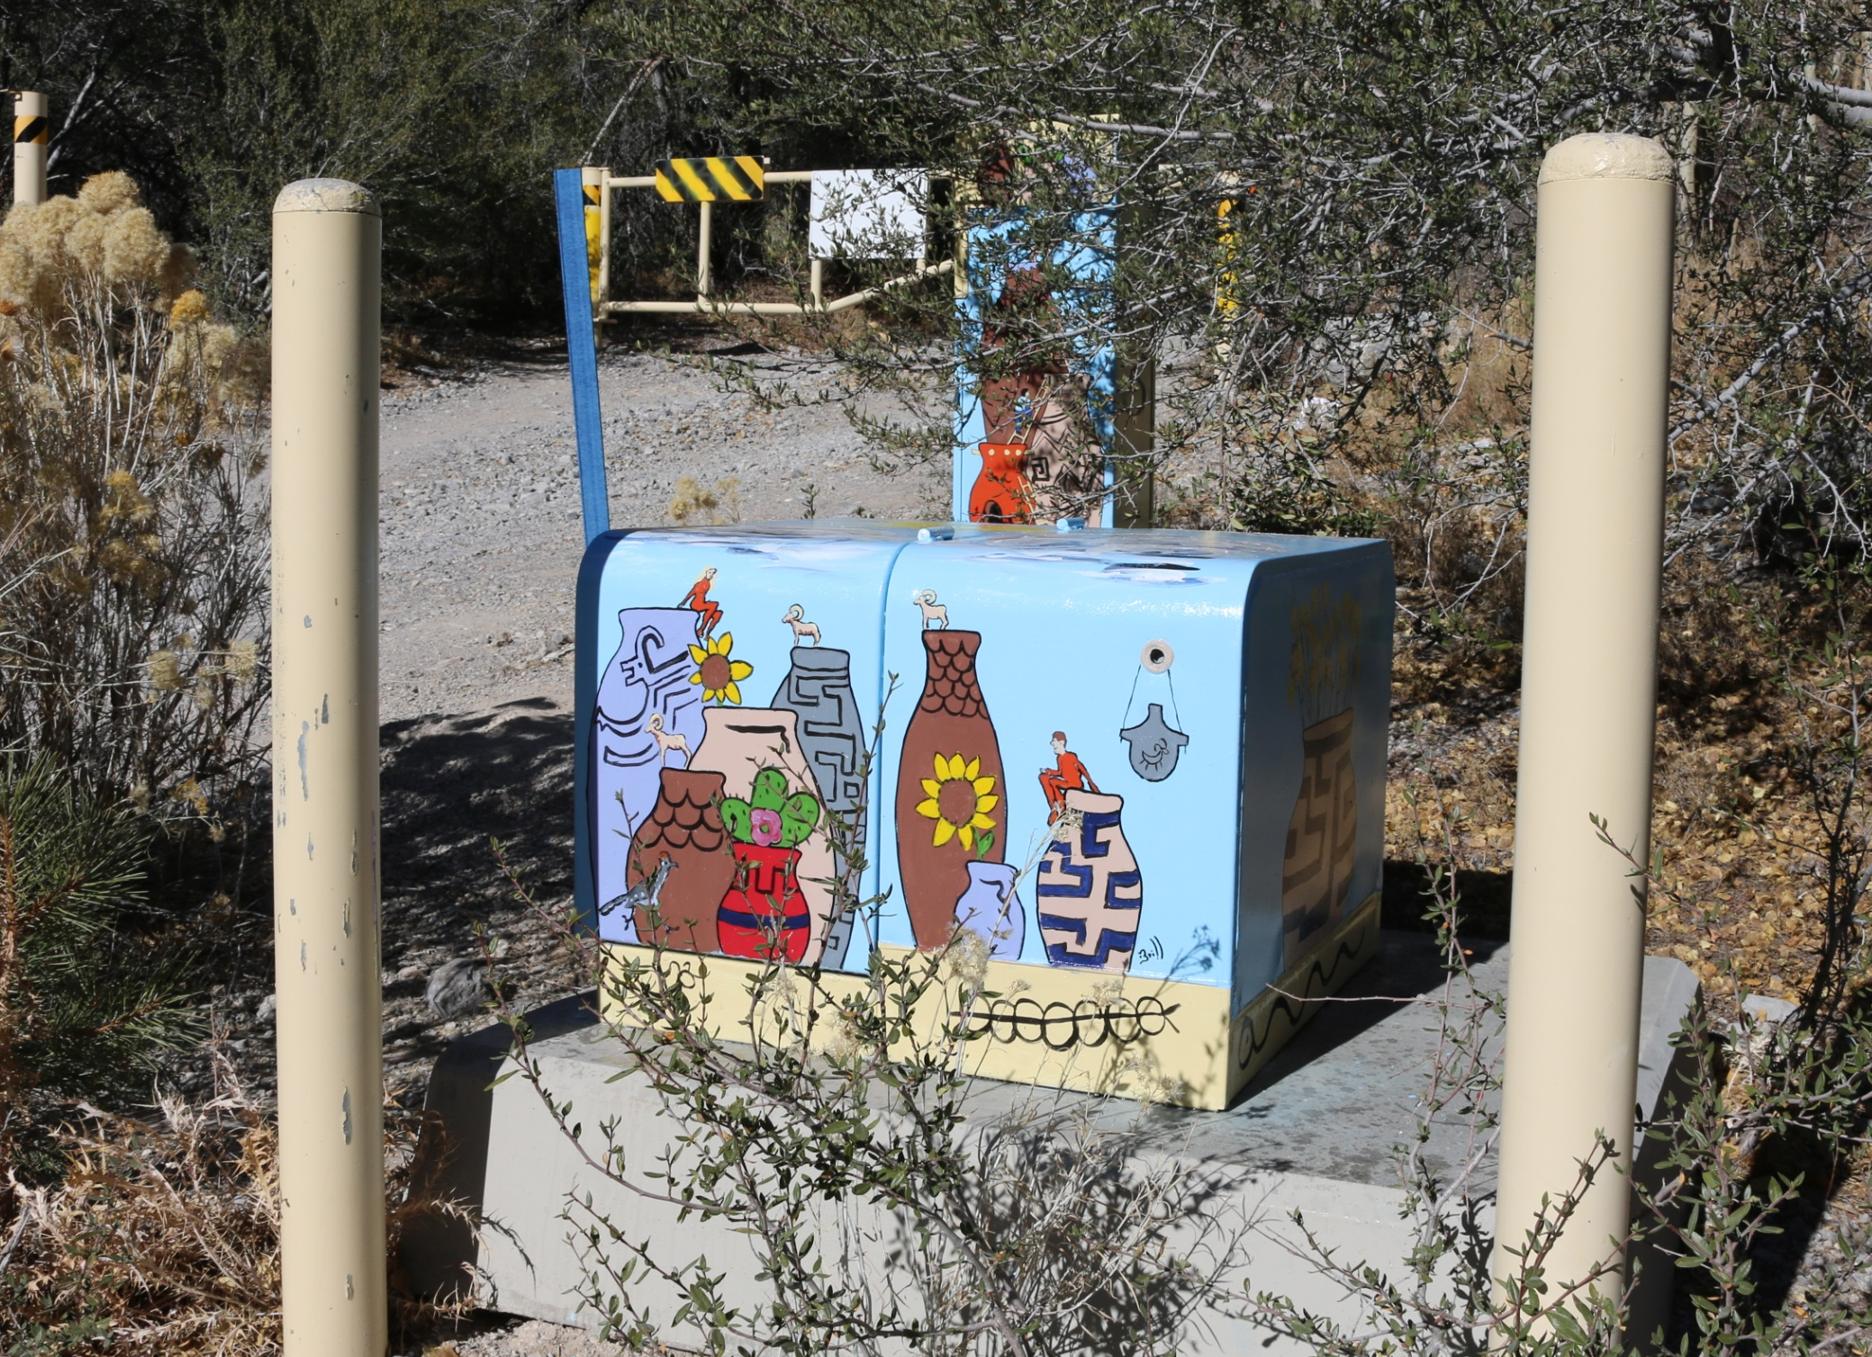

Slide 27
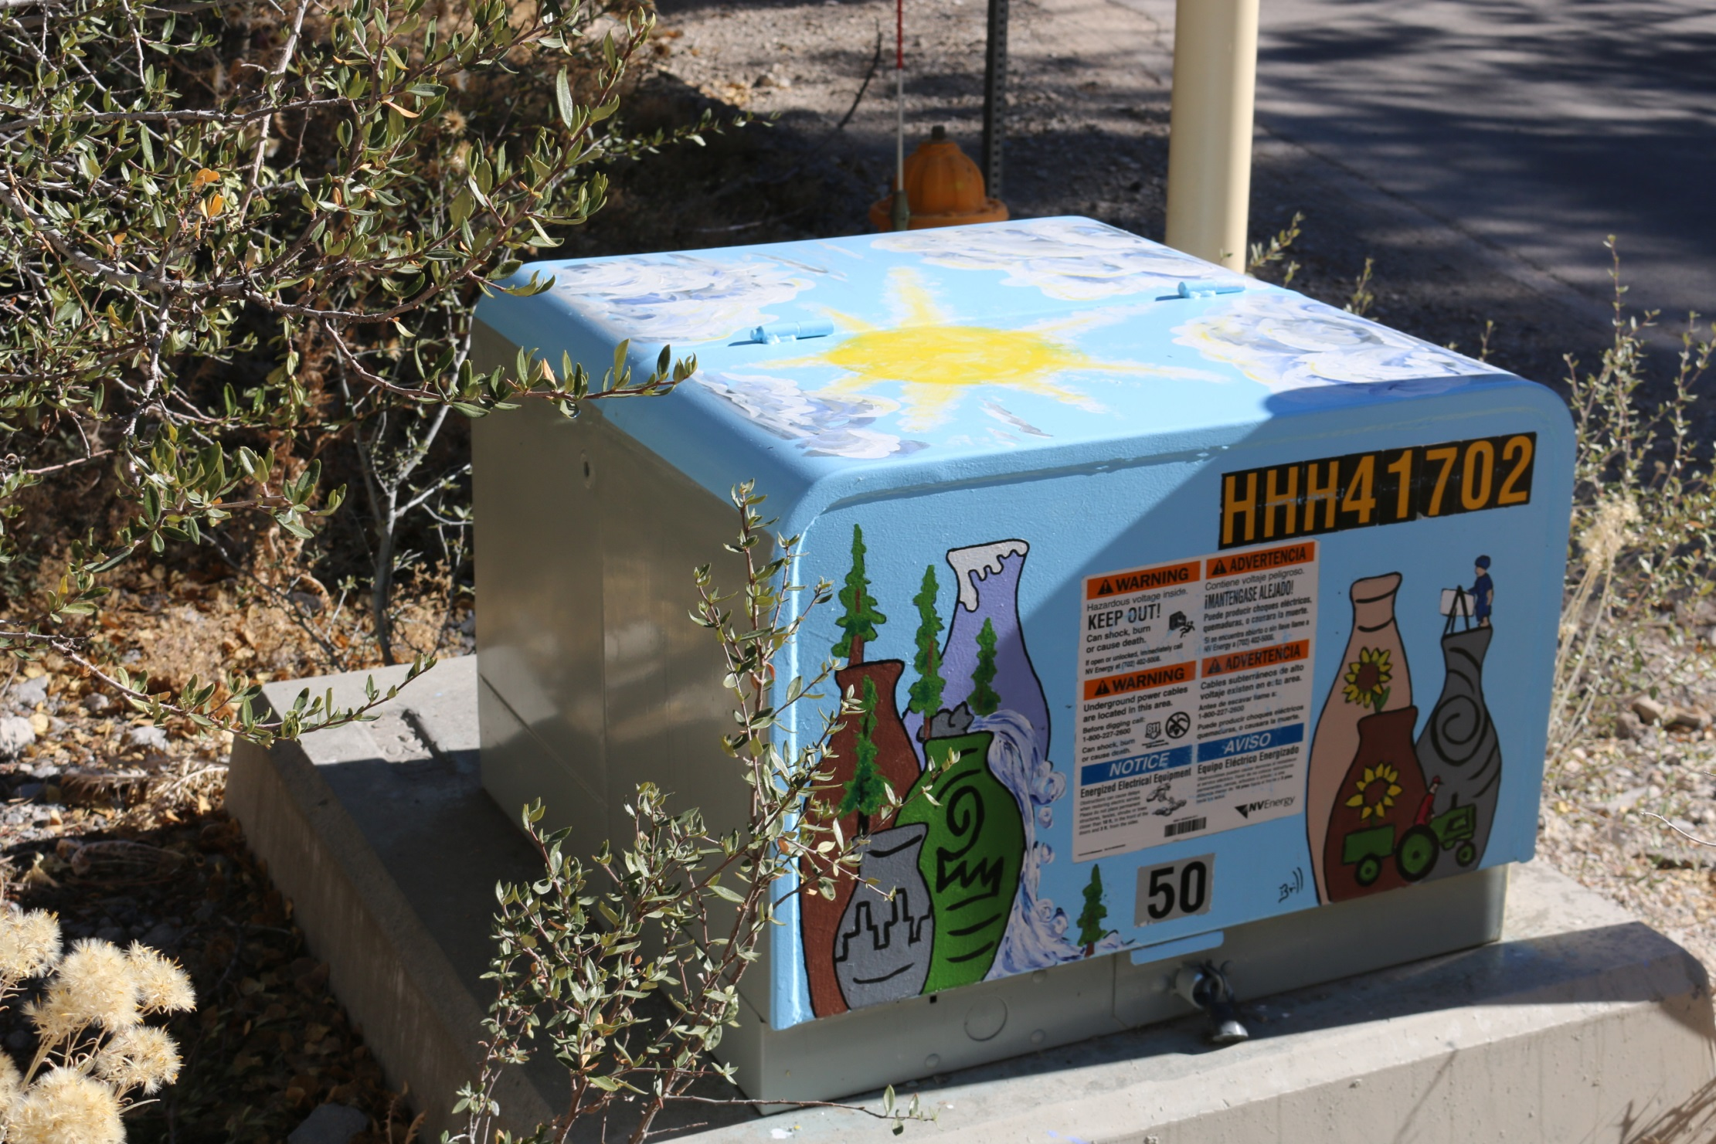

Slide 28
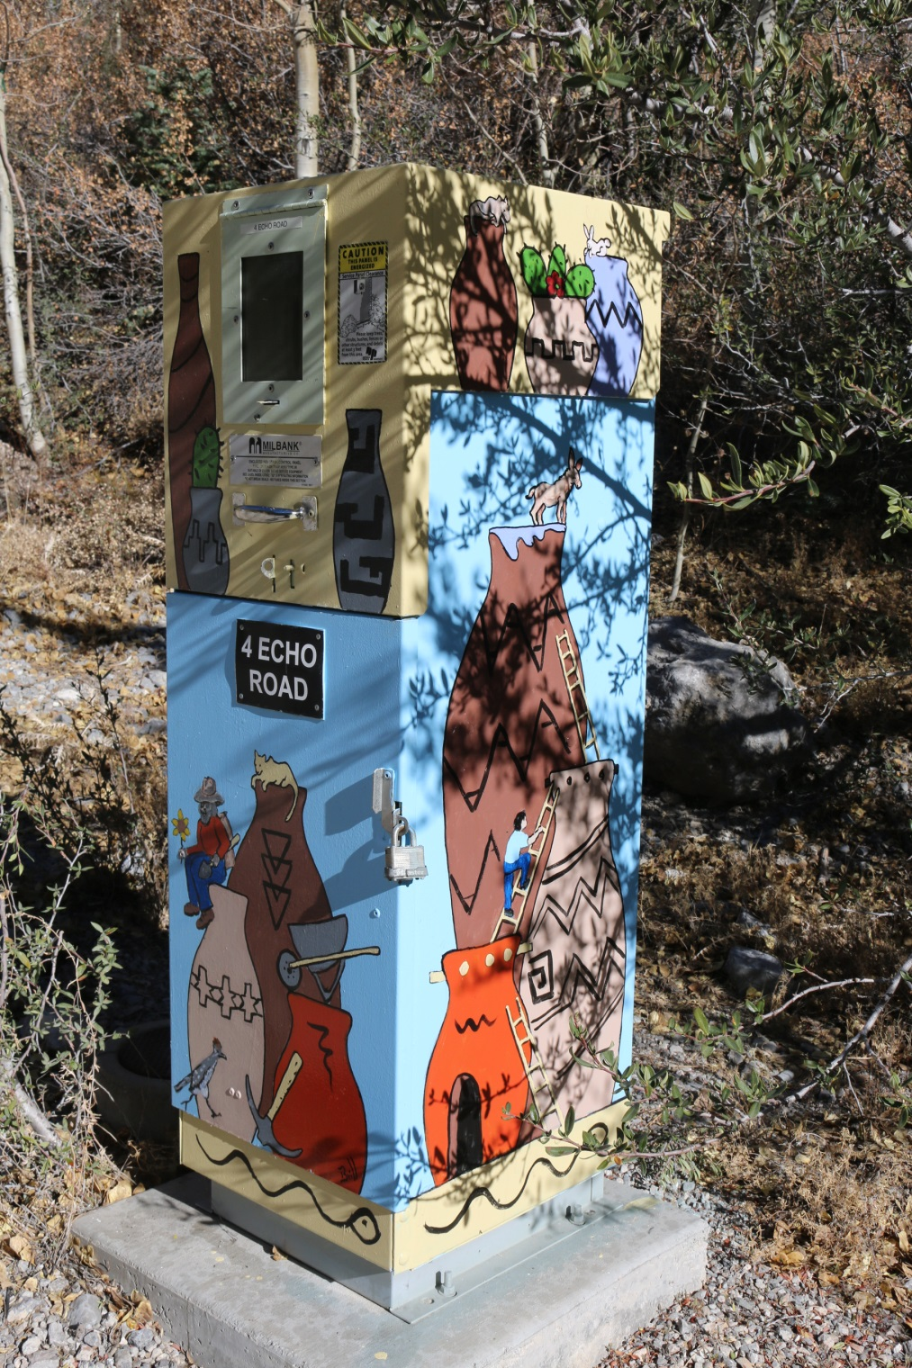
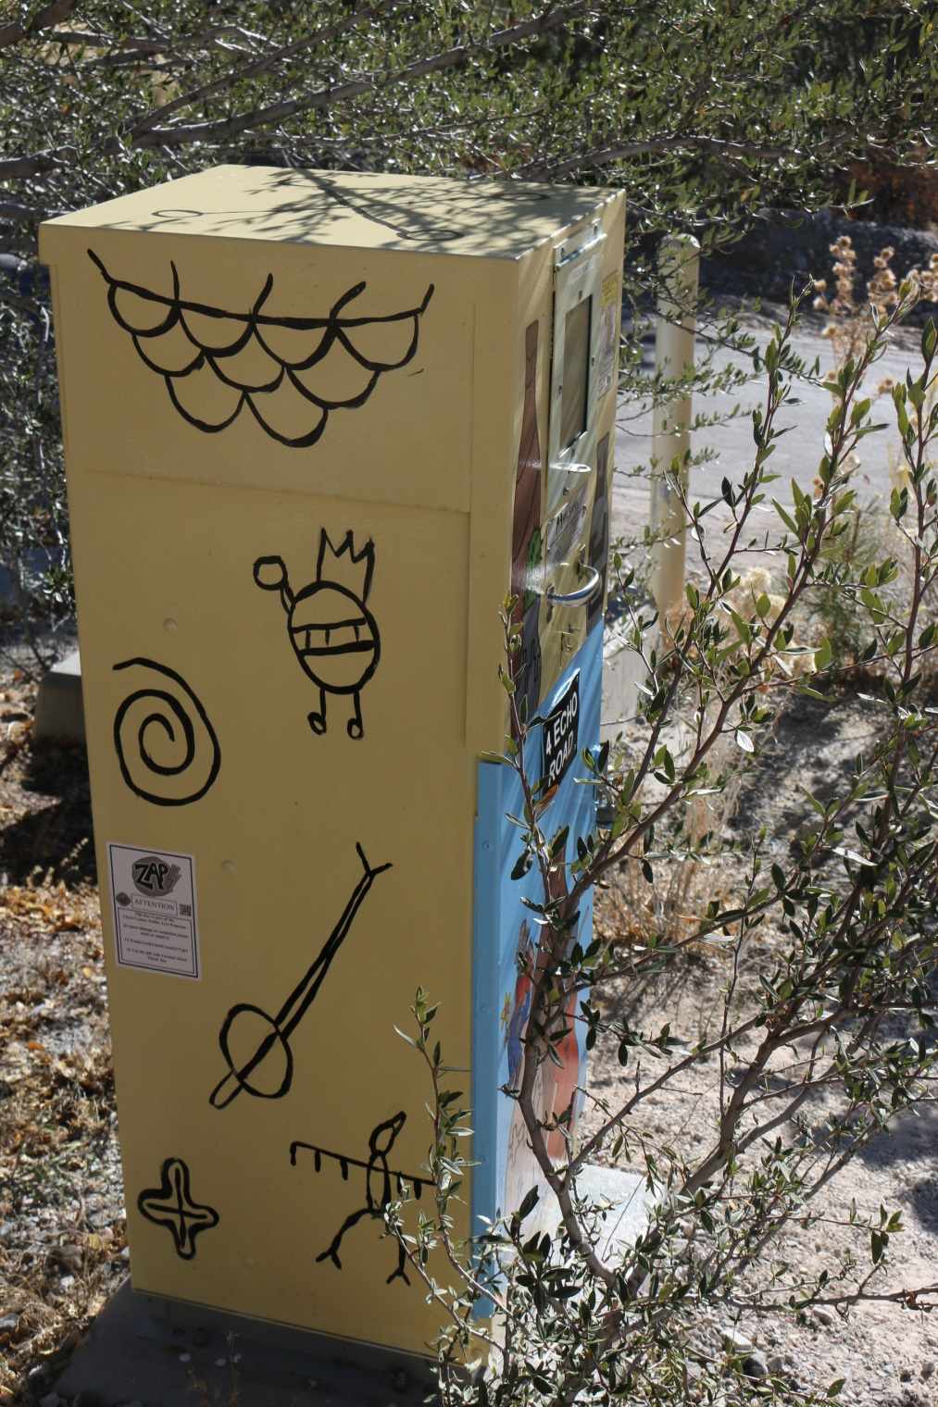

Slide 29
Aniko Doman
Group 4 – 5001 Kyle Canyon Rd (by Forest Valley Residence)
I feel a natural affinity to design and paint public art that engages viewers intellectually, emotionally, and aesthetically. I am also thrilled about the opportunity to create art for a natural environment.
As a resident of the Vegas Valley for over three decades, I have grown to love our natural surroundings and cherish the flora and fauna we are surrounded with. I am a frequent visitor and hiker to the Mt. Charleston/Kyle Canyon area, and have enjoyed the beauty of the Spring Mountains and surrounding Mojave Desert in every season and weather over the years.
▫▫▫▫▫▫▫▫▫▫
This opportunity would be a highly desired opportunity for me to create artwork located in nature. I would also be happy to meet and listen to community partners, and hear their ideas what might be appropriate art for their neighborhood. I will also bring my ideas for creating images that reflect my decades worth of wonderful memories of Mt. Charleston, my deep connection to and love of this very unique area in our desert - the colors of the rocks, the textures of a small lichens, the sound of the wind in the canyons, the smell of wet sage and pine trees whirling in a thunderstorm... to name just a few. I want to visually explore abstract shapes of things that connect us to nature, objects that are simple yet impressive to our senses, shapes that easily relate to its viewers, enliven the artwork site with colors, stimulate wondering, and start a conversation.
My hope is that my artistic skills, vision, experiences and past successes will make me a chosen candidate for this commission. I will bring enthusiasm and professionalism to complete a well-executed public art project - on time, on budget, and in astute collaboration with neighborhood residents and business.

Slide 30
/ 3 boxes

Slide 31
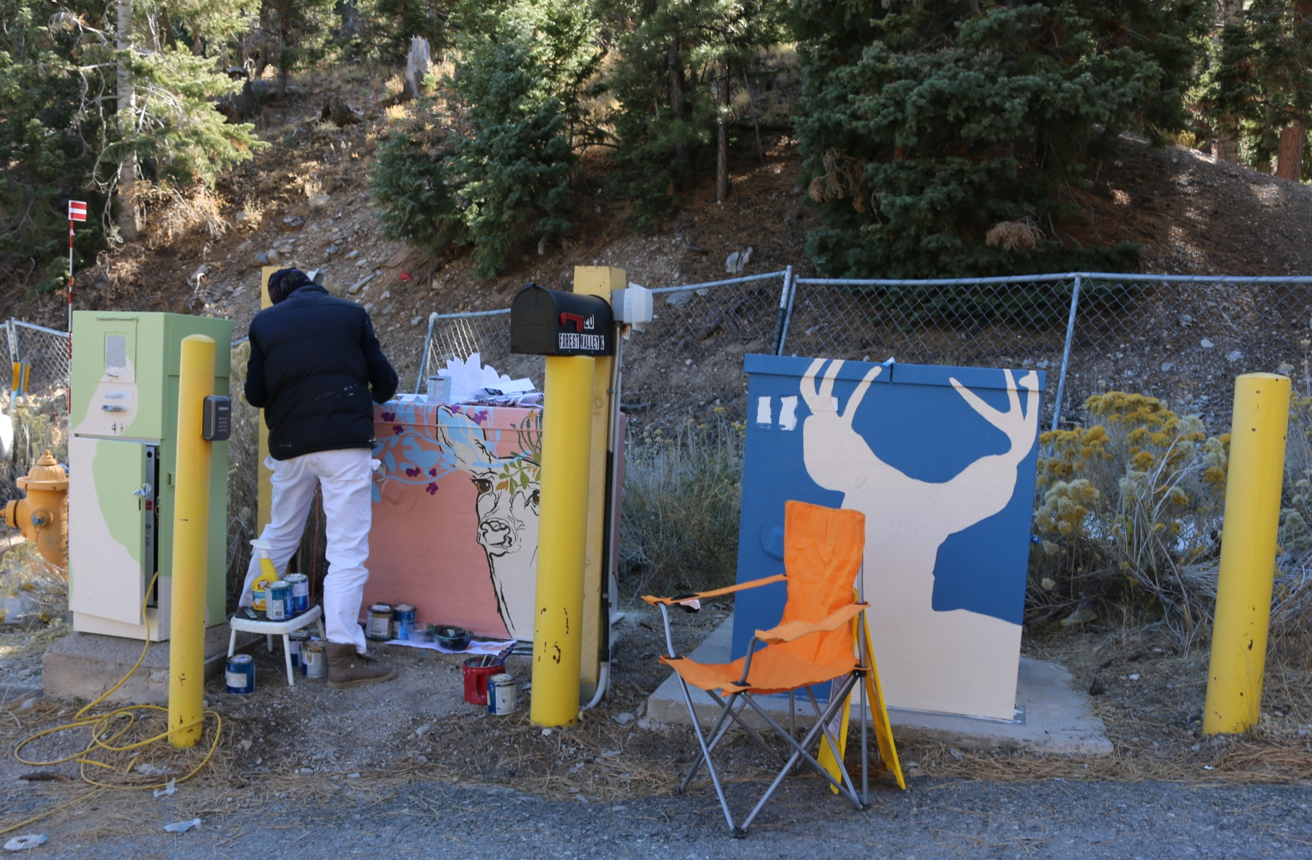
Aniko Doman

Slide 32
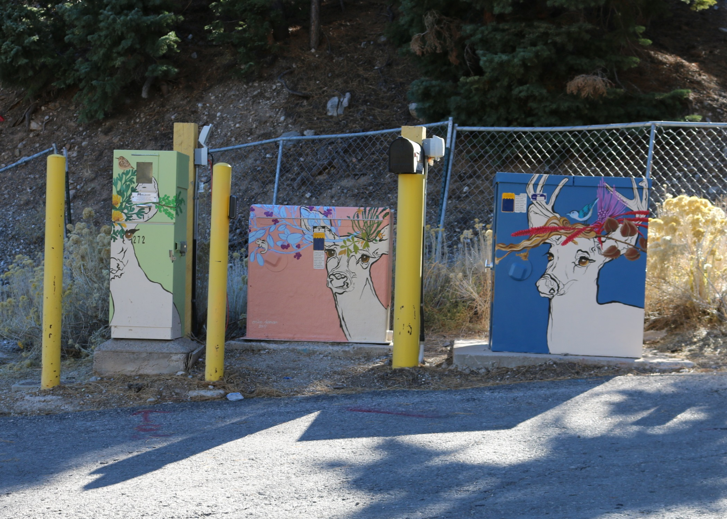

Slide 33
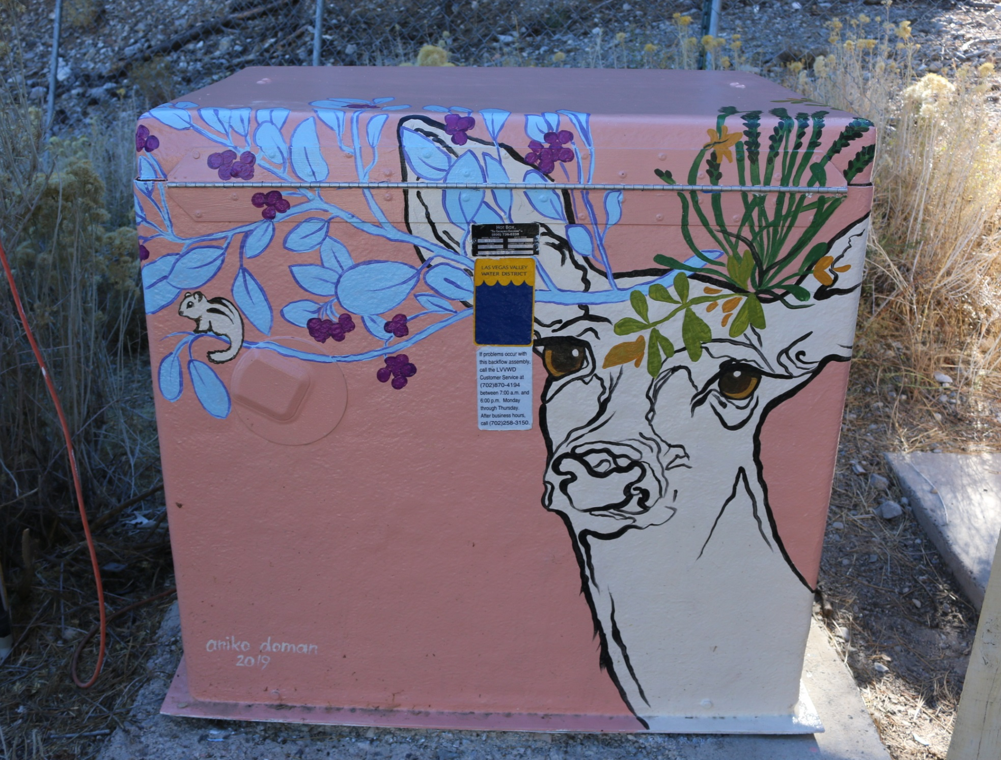

Slide 34
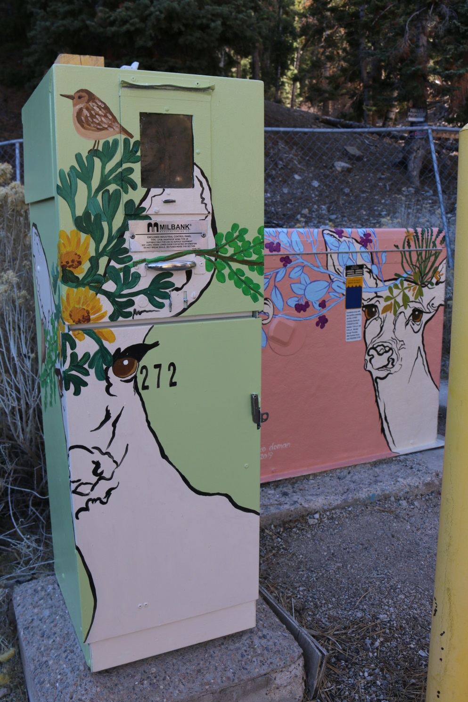
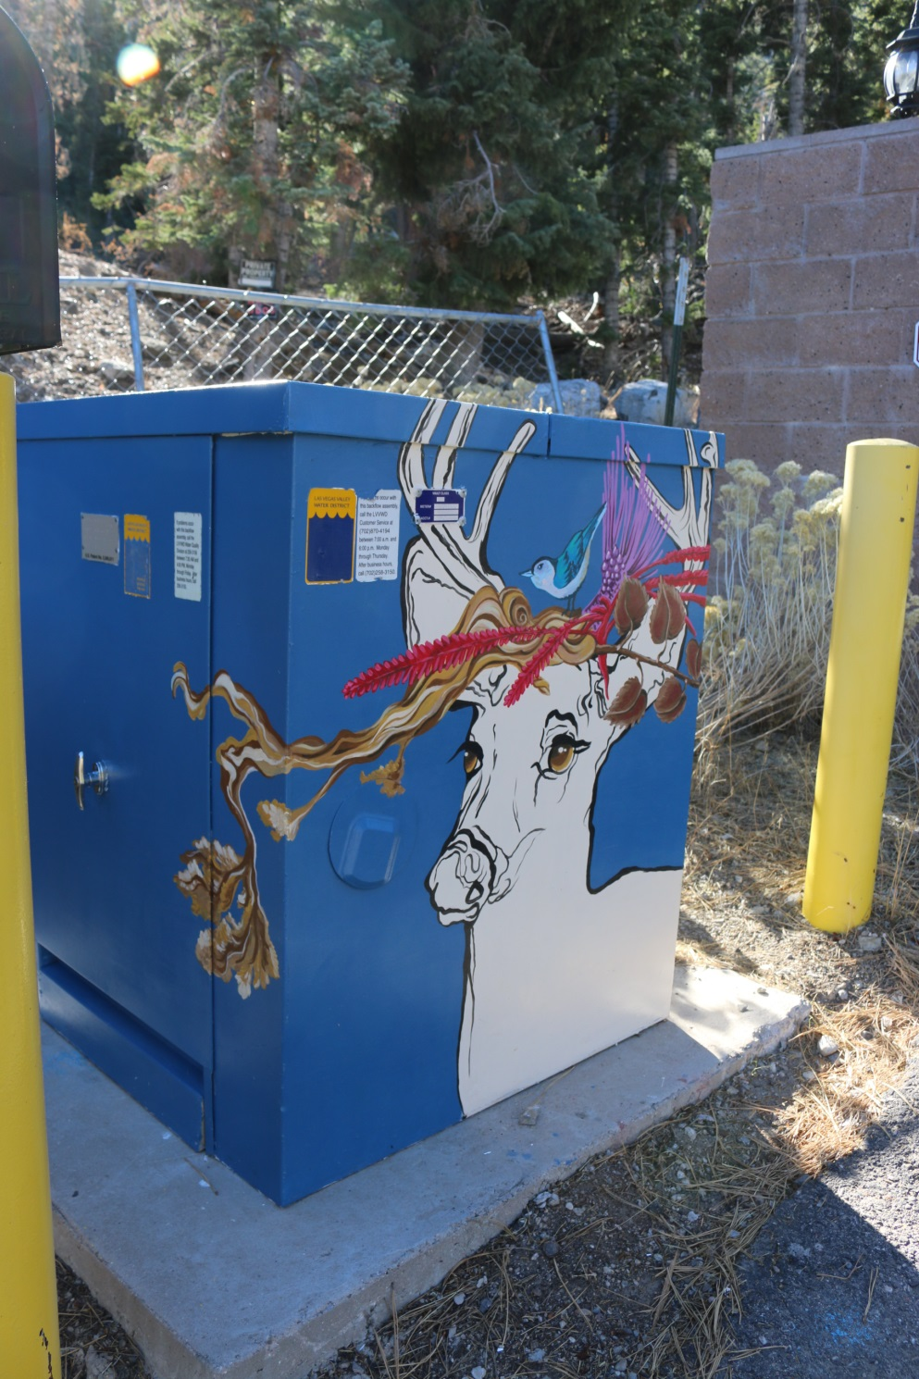

Slide 35
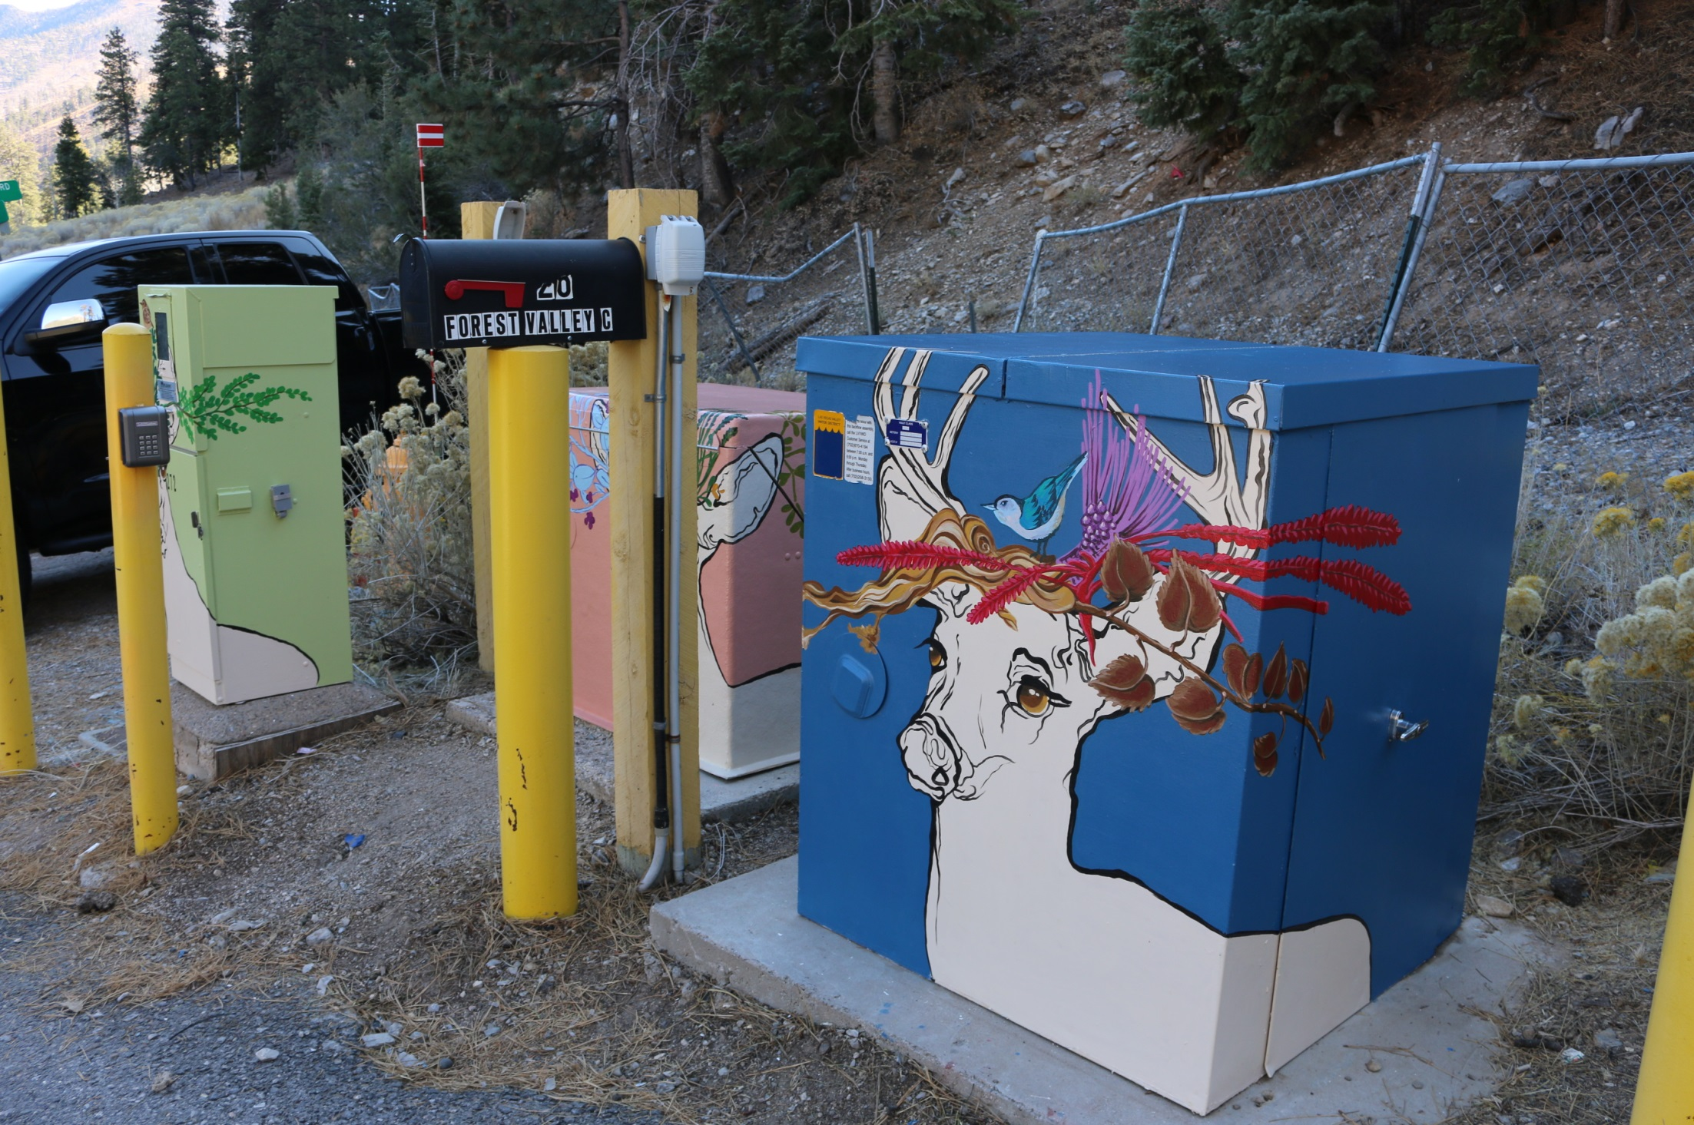

Slide 36
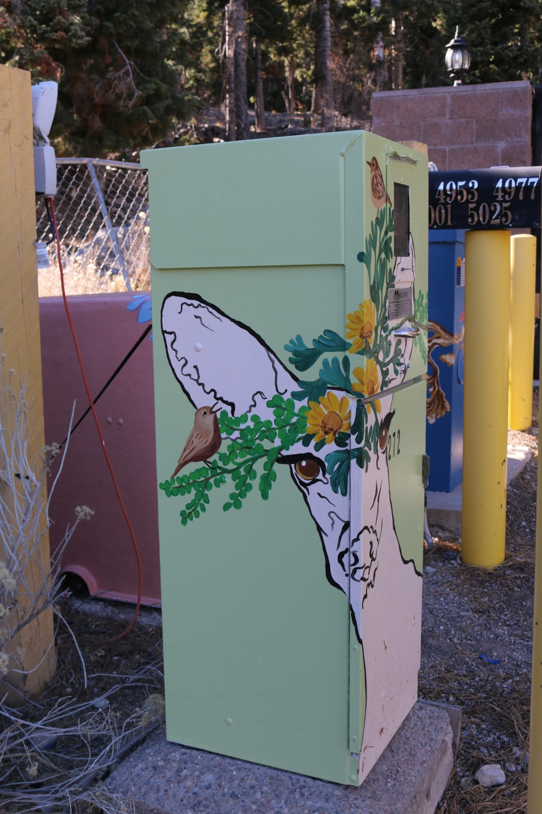
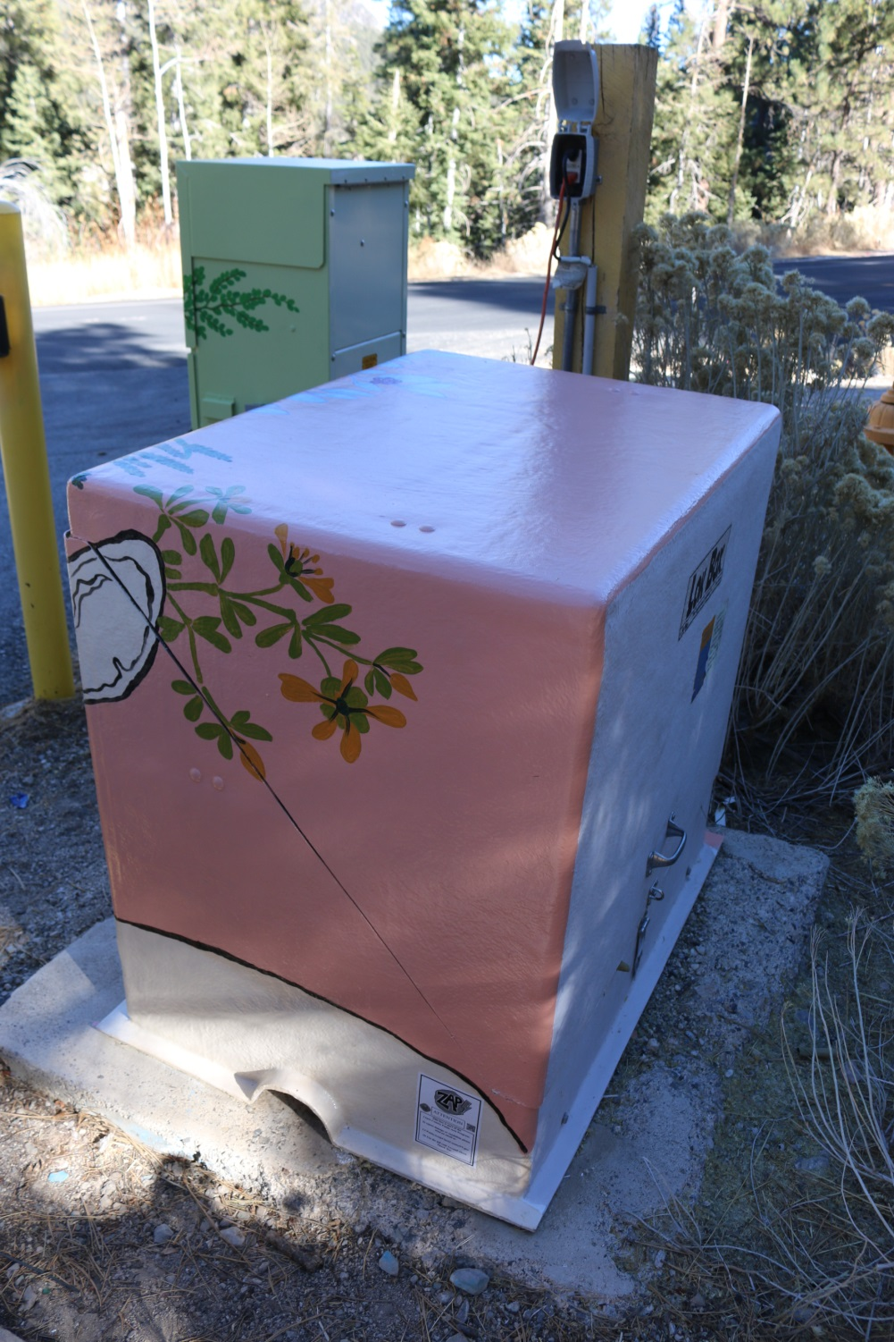

Slide 37
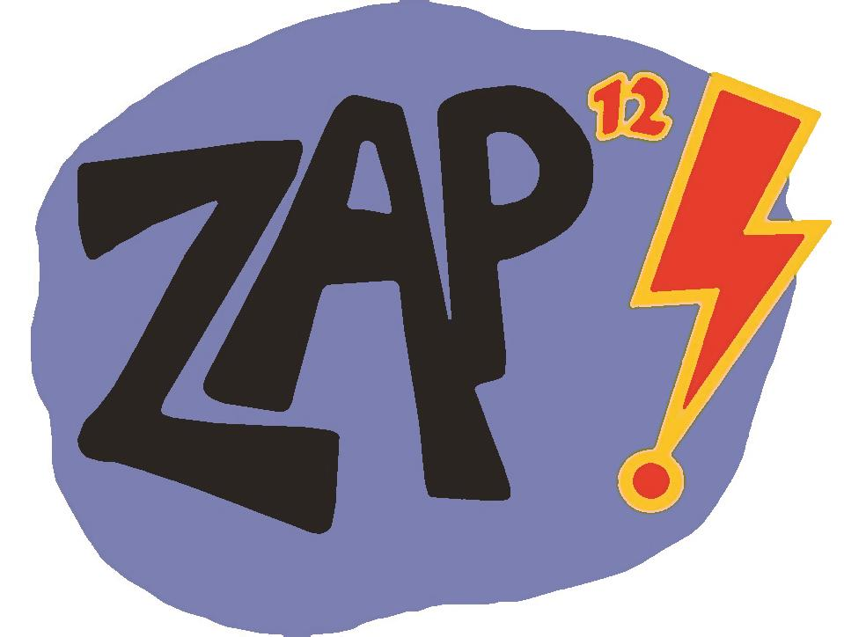
To explore past Zap! projects, go to: https://www.clarkcountynv.gov/parks/Pages/zap-homepage.aspx
Thank you!
Patty Dominguez – Zap! Public Art Coordinator
Patty.Dominguez@ClarkCountyNV.gov

